Slide 1

Electric Vehicle Population Growth: A Year-by-Year Analysis
Presented By: Deepthi Sivasankara Pillai
Date: February 18, 2025

Slide 2
Project Overview and Data Sources
Industry Chosen: Automotive
Objective: To analyze the expansion and trends within the electric vehicle sector over time, emphasizing key patterns and regional variations.
Selected Data Set: Electric_Vehicle_population_Data.csv
Data Set Origin: Kaggle
Application Areas: Market Analysis; Growth Trend Evaluation; Demographic Study
GitHub : https://github.com/deepthipillai1/Electric-Vehicle-Population-Analysis

Slide 3
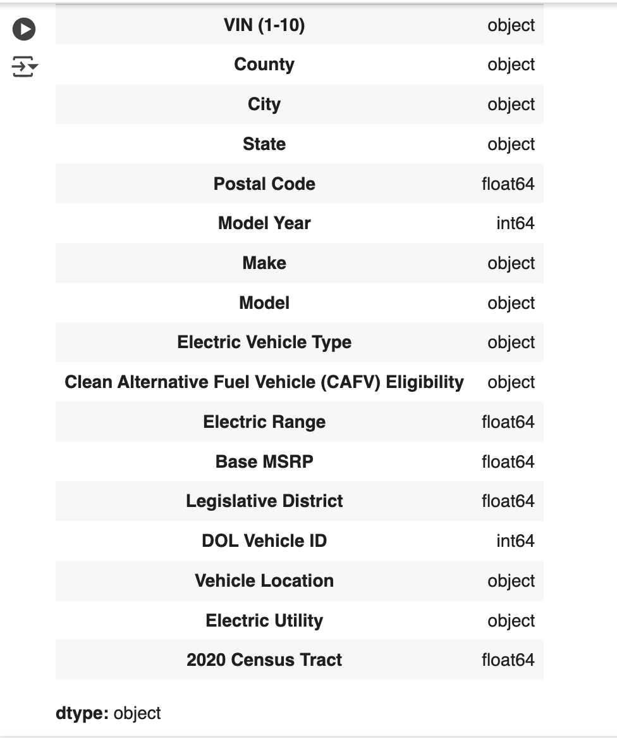

Importing Dataset and Identifying the fields and datatypes

Slide 4

Determining the number of records in the data frame.

Slide 5
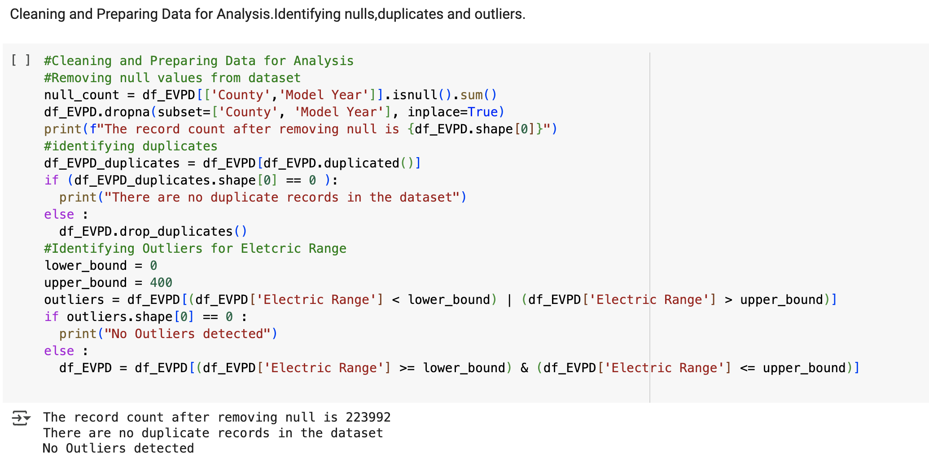
Cleaning ,Preparing and Organizing Data

Slide 6

Renaming the columns for better readability

Slide 7
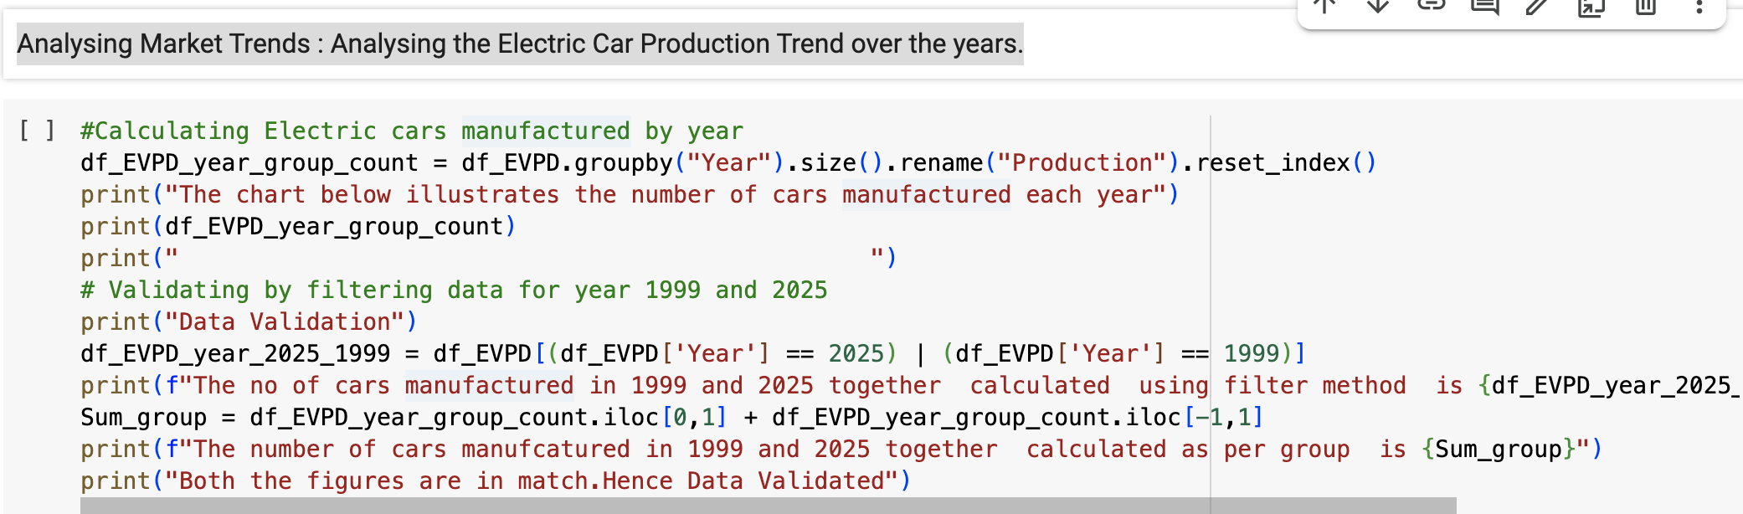
Market Trends : Analysing the Electric Car Population Trend over the years.

Slide 8
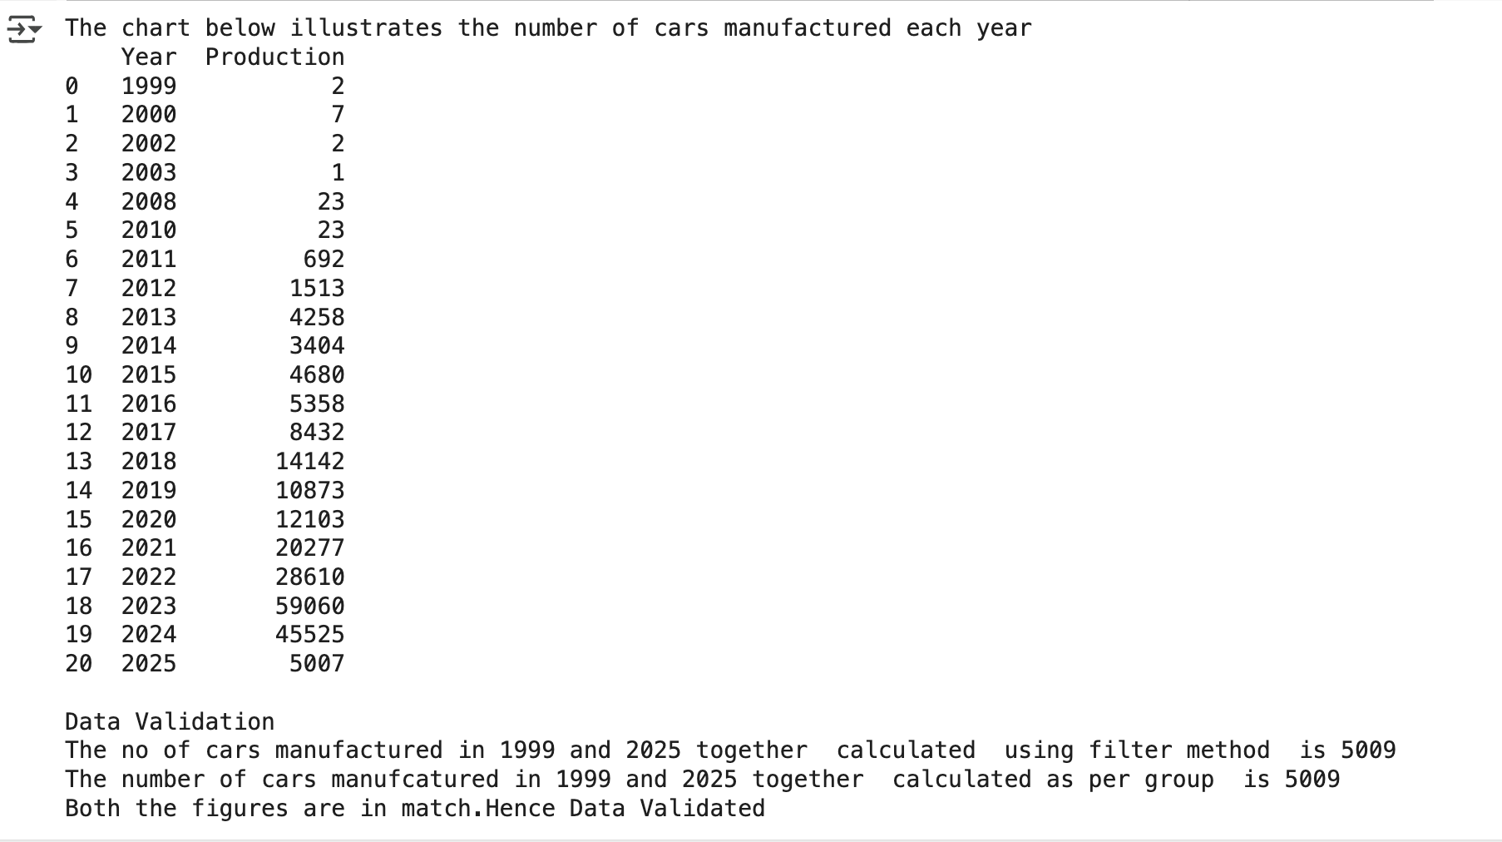
Market Trends : Analysing the Electric Car Population Trend over the years.

Slide 9
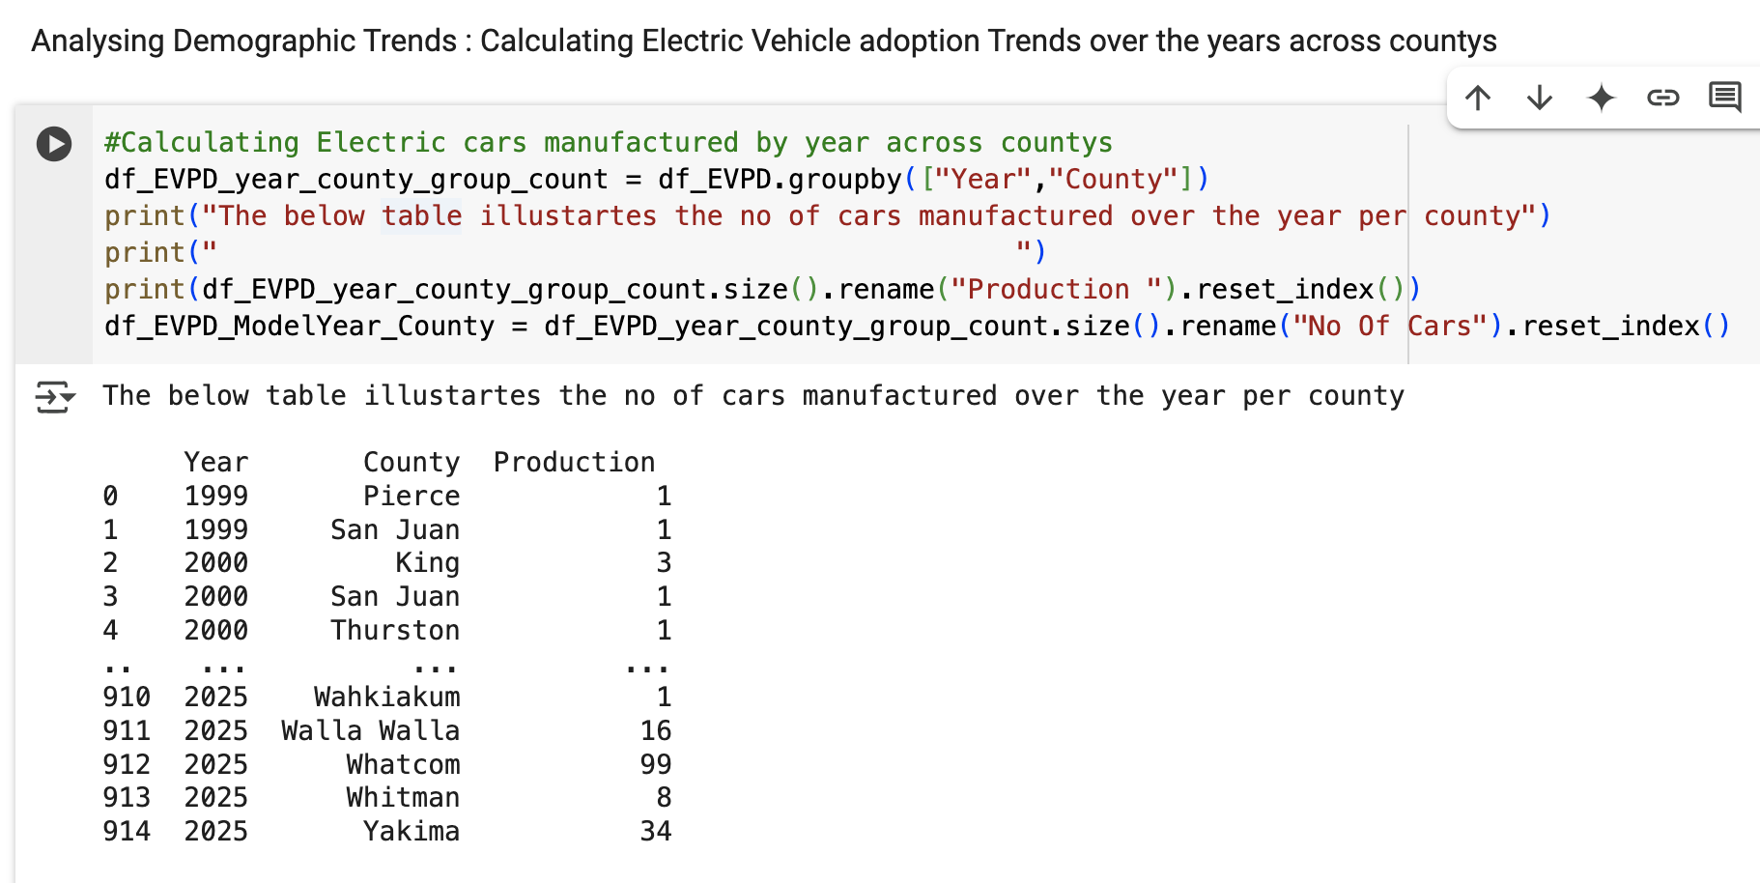
Demographic Trends: Assessing Electric Vehicle Adoption Patterns Over the Years Across Various Regions

Slide 10

Summary Statistics : Average Population over the years

Slide 11
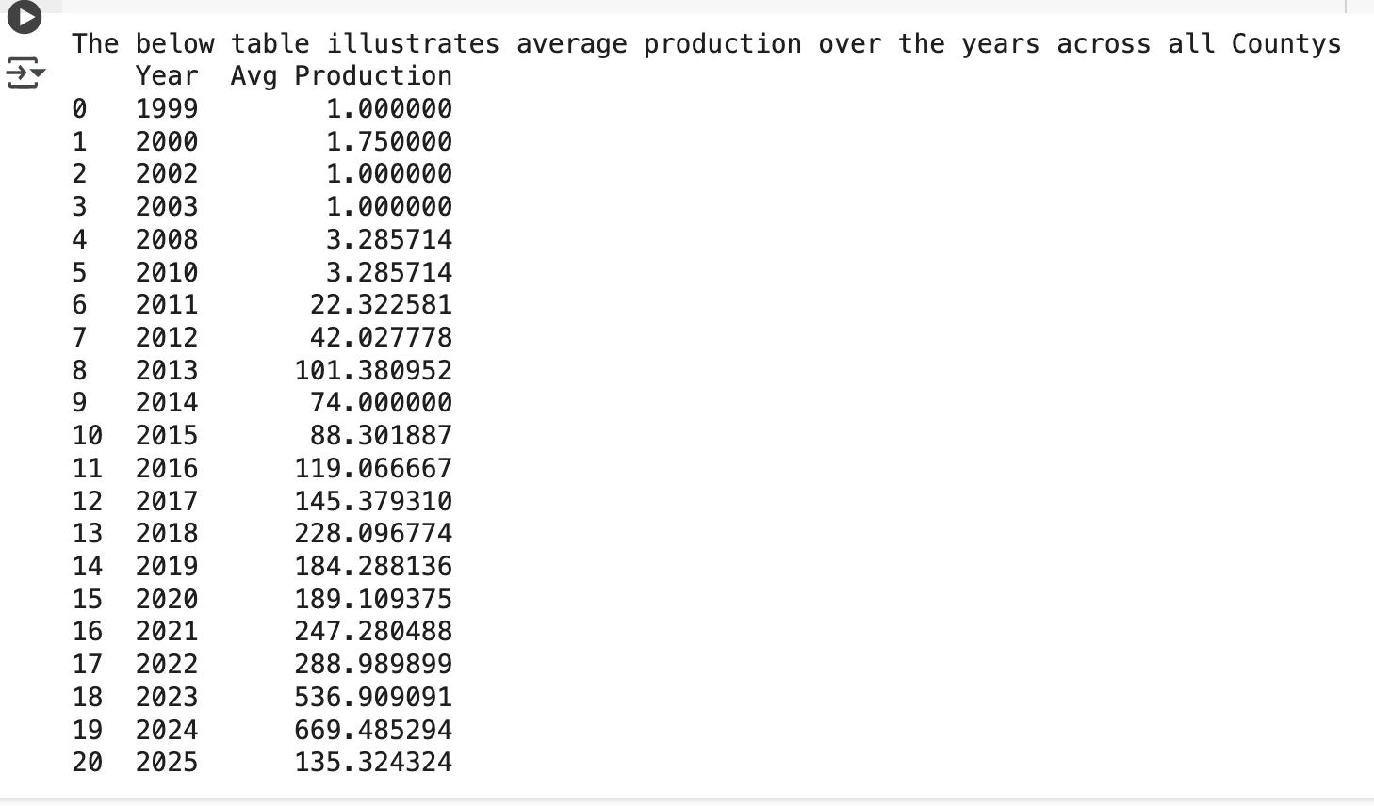
Summary Statistics : Average Population over the years

Slide 12
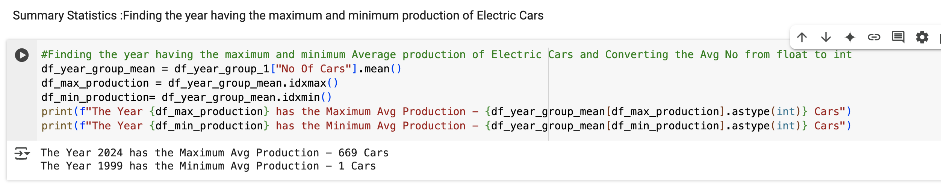
Summary Statistics :Finding the year having the maximum and minimum population of Electric Cars

Slide 13

Demographic Statistics : Analysing Electric Car adoption of State's over the years

Slide 14
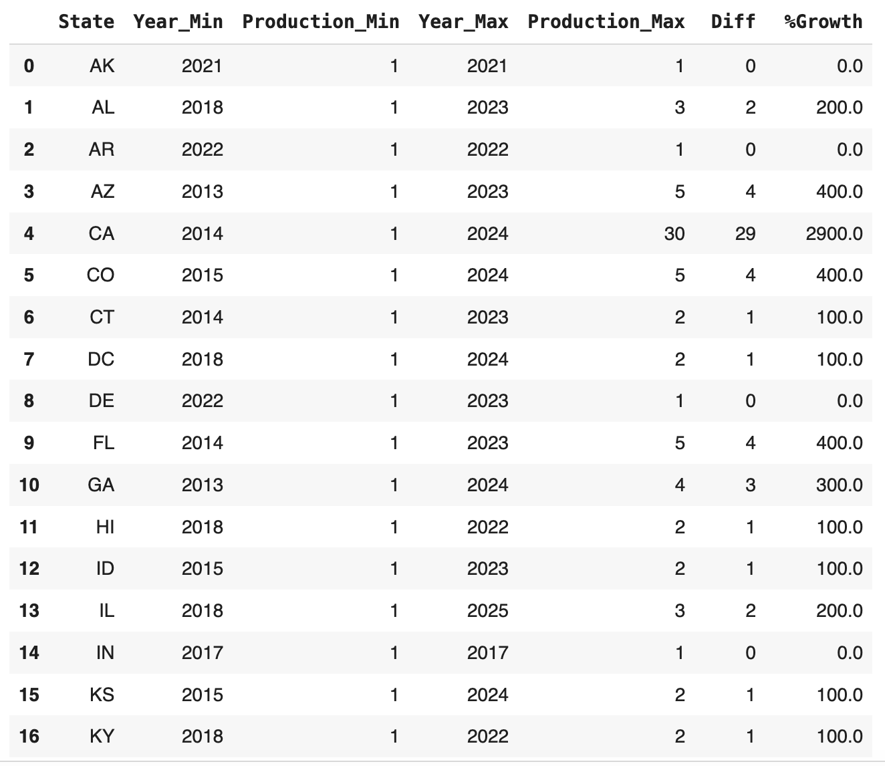
Demographic Statistics : Analysing Electric Car adoption of State's over the years

Slide 15
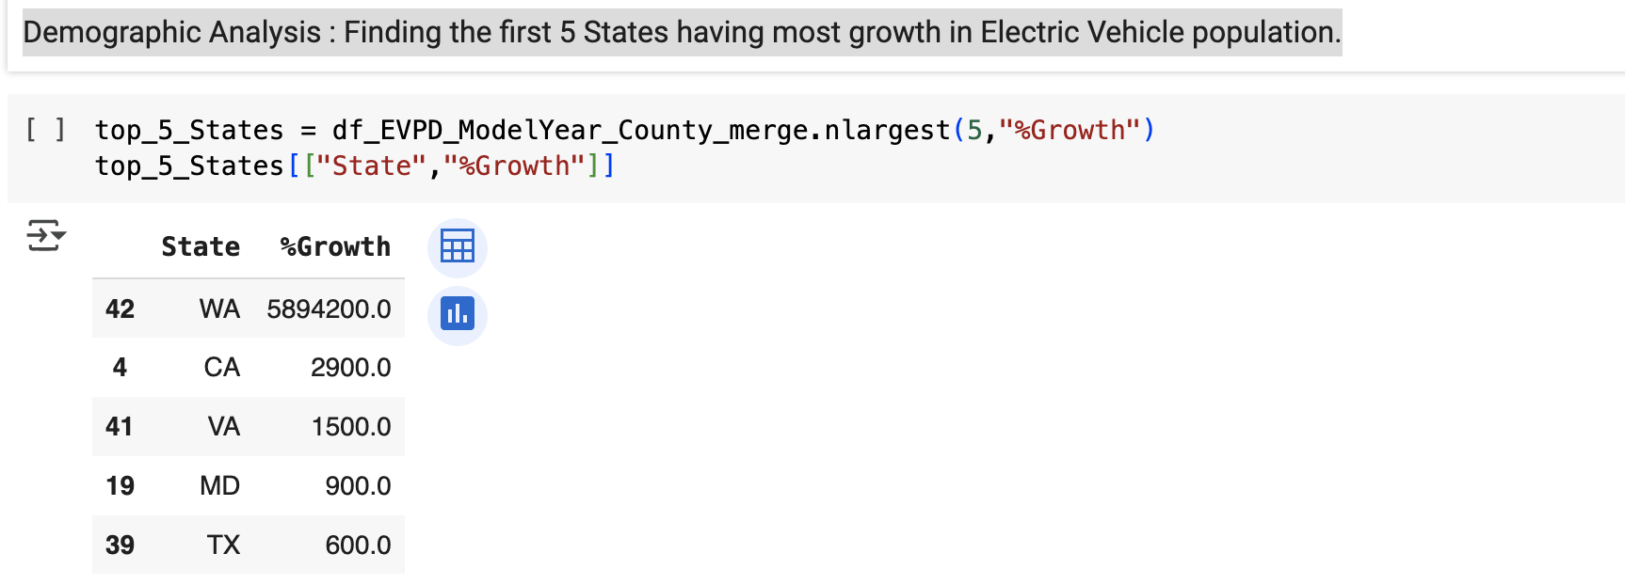
Demographic Analysis: Identifying the top 5 states with the highest growth in Electric Vehicle numbers.

Slide 16
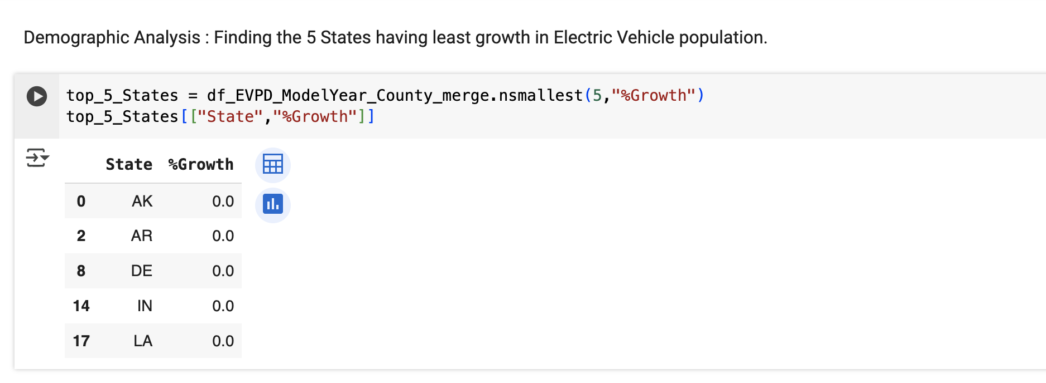
Demographic Analysis : Identifying the 5 states with the lowest growth in Electric Vehicle numbers.

Slide 17
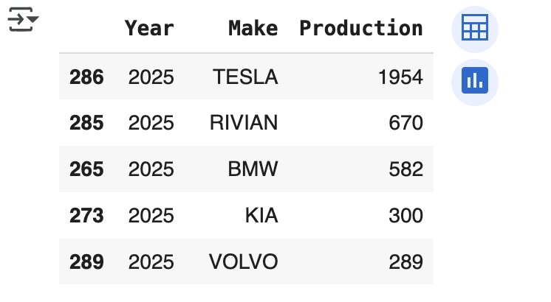
Market Trends: Identify the Electric Car Models Populated each year

Slide 18
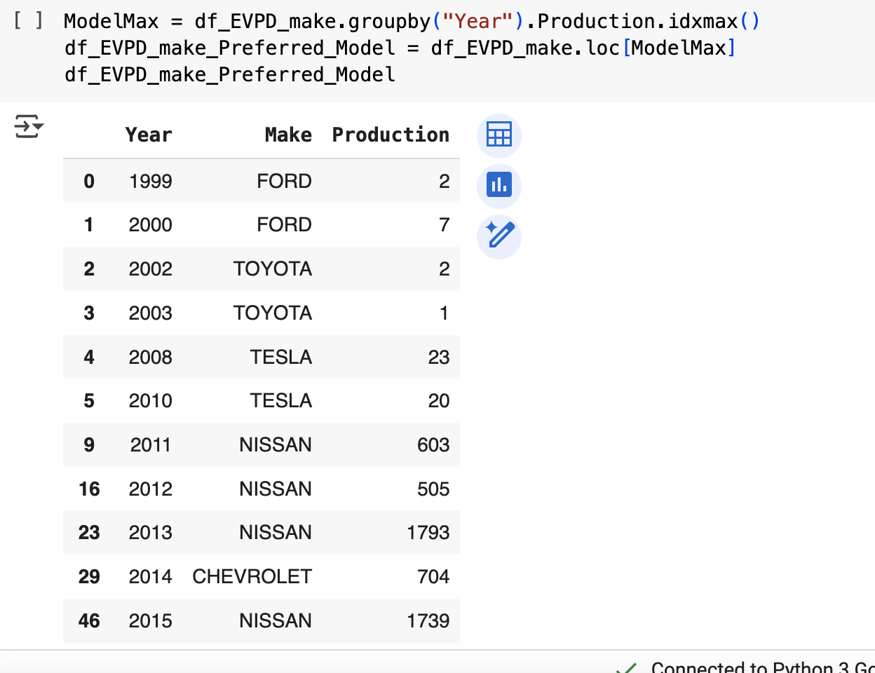
Market Trends: Identifying the Most Popular Car Model and Total Population from 1999 to 2025

Slide 19
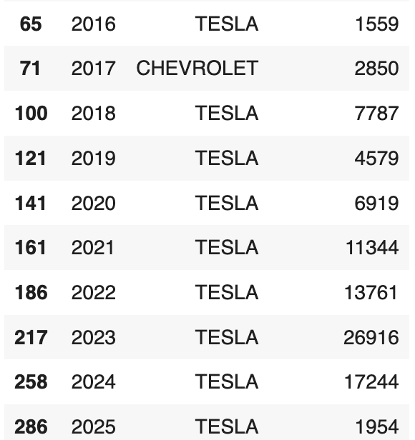
Market Trends: Identifying the Most Popular Car Model and Total Population from 1999 to 2025

Slide 20
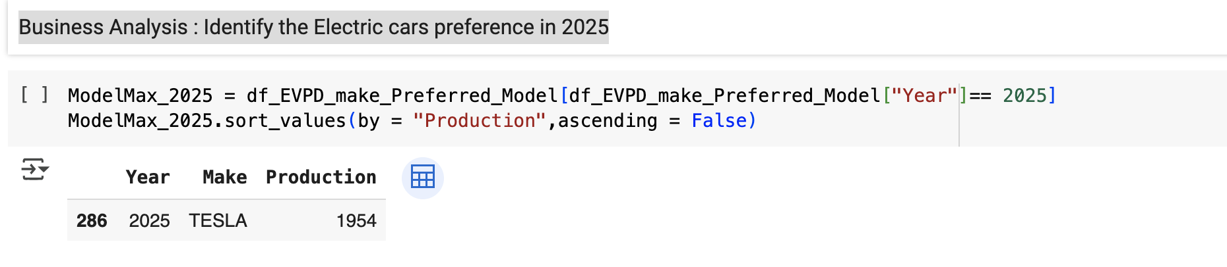
Market Trends: Identifying the most preferred model in 2025

Slide 21
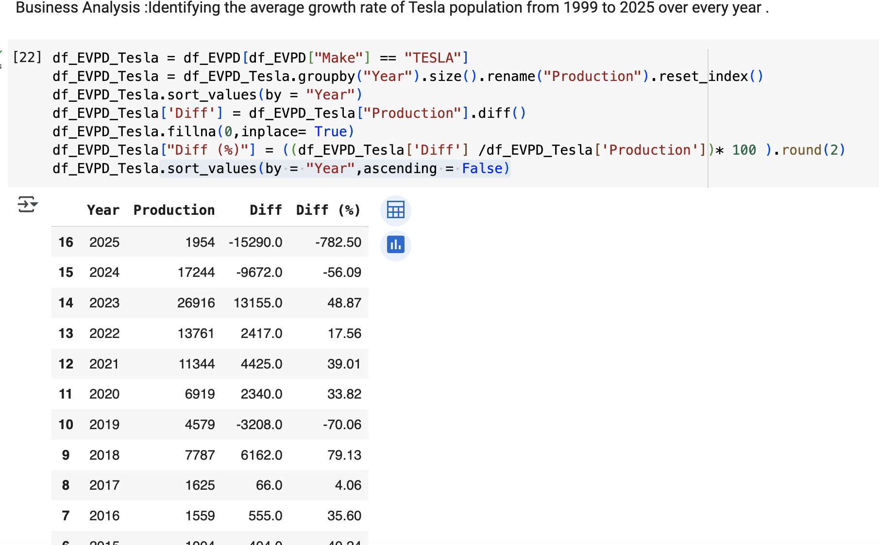
Market Trends: Identifying the average growth rate of Tesla population from 1999 to 2025

Slide 22
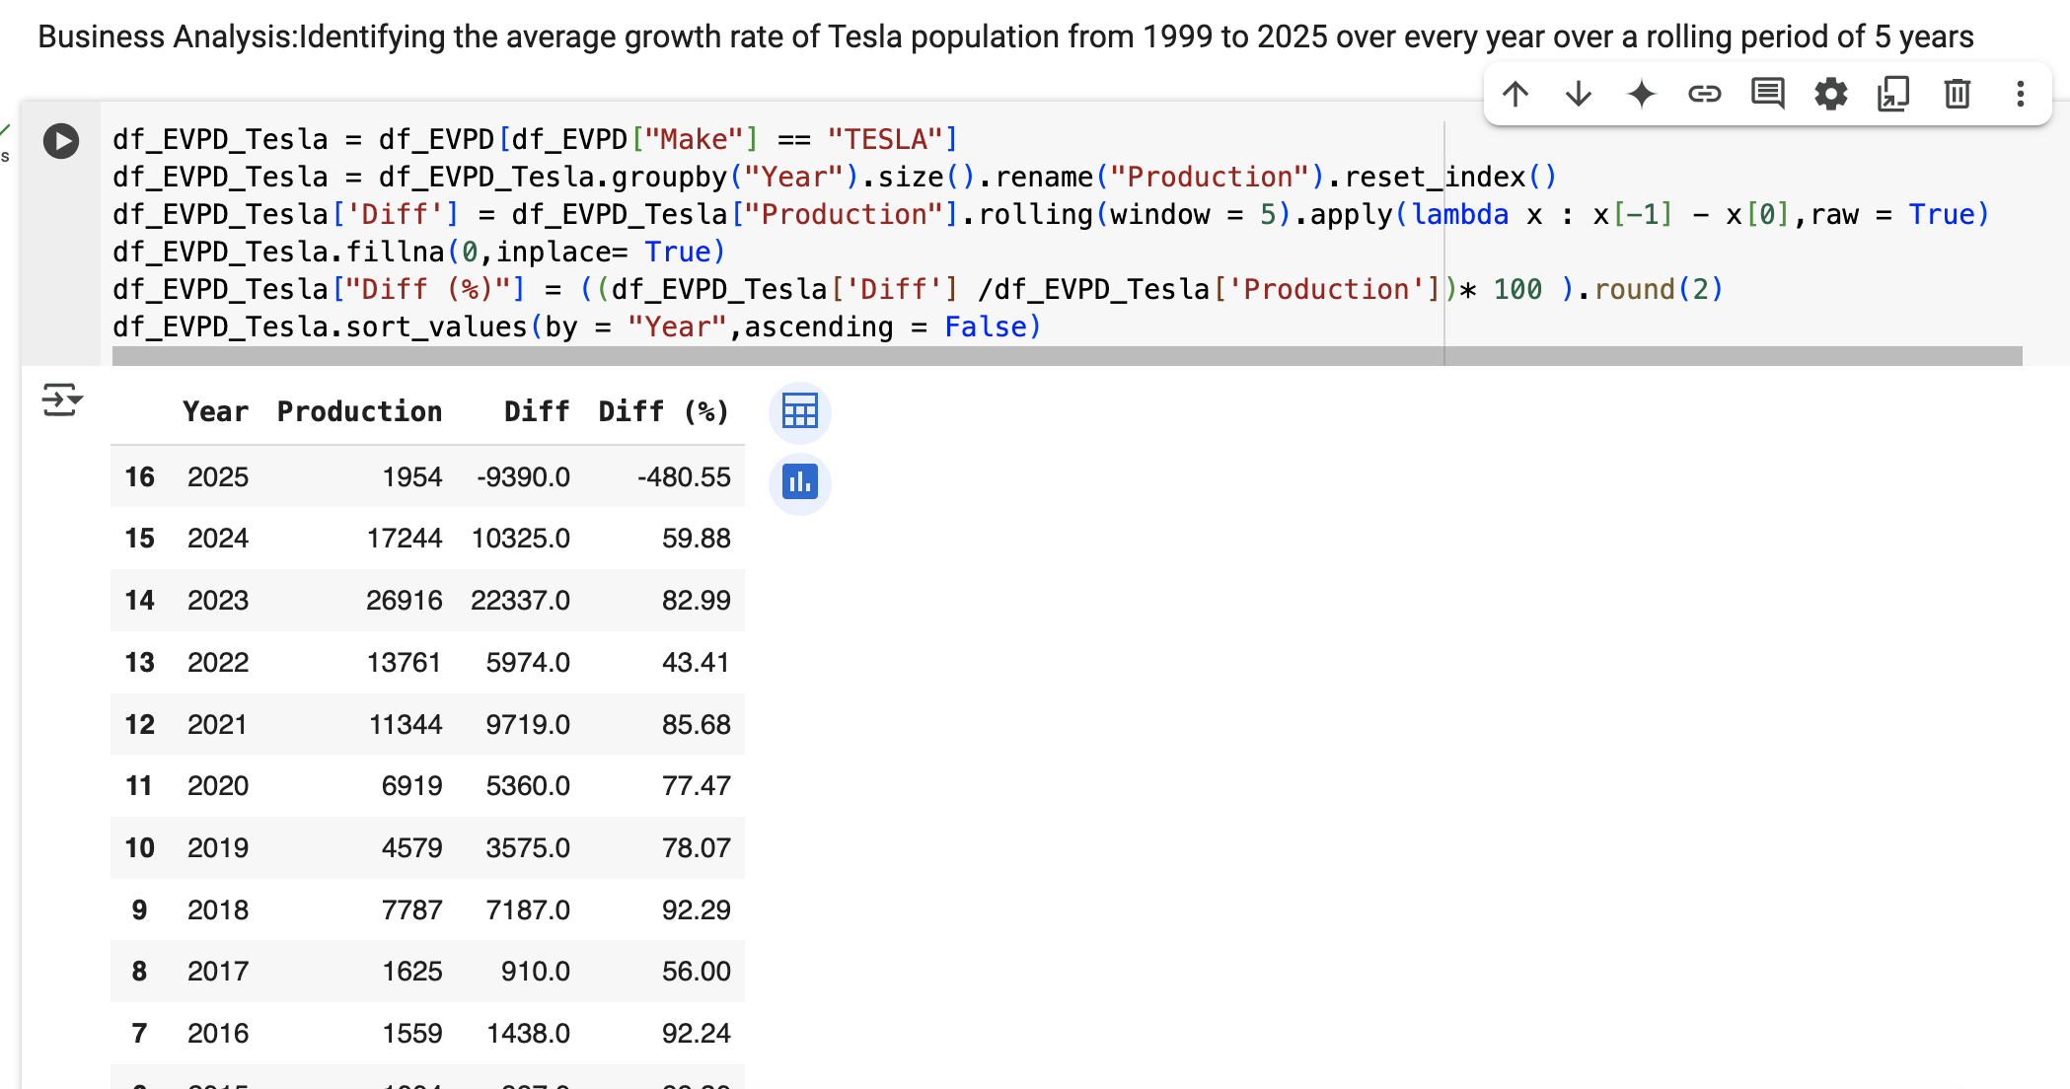
Market Trends: Identifying the average growth rate of Tesla population from 1999 to 2025 over every year over a rolling period of 5 years

Slide 23
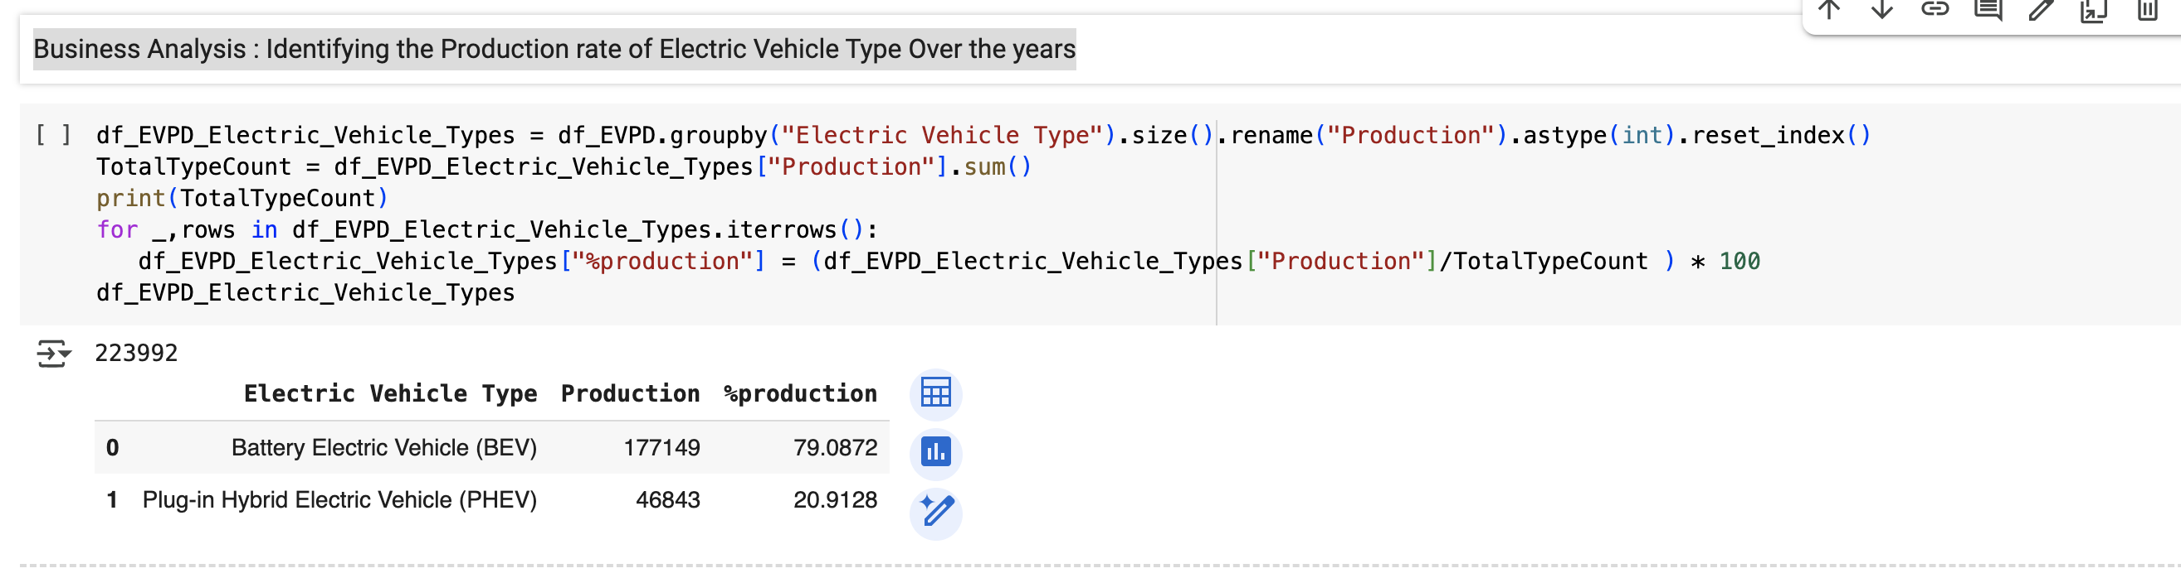
Market Trends: Identifying the Population rate of Electric Vehicle Type Over the years

Slide 24
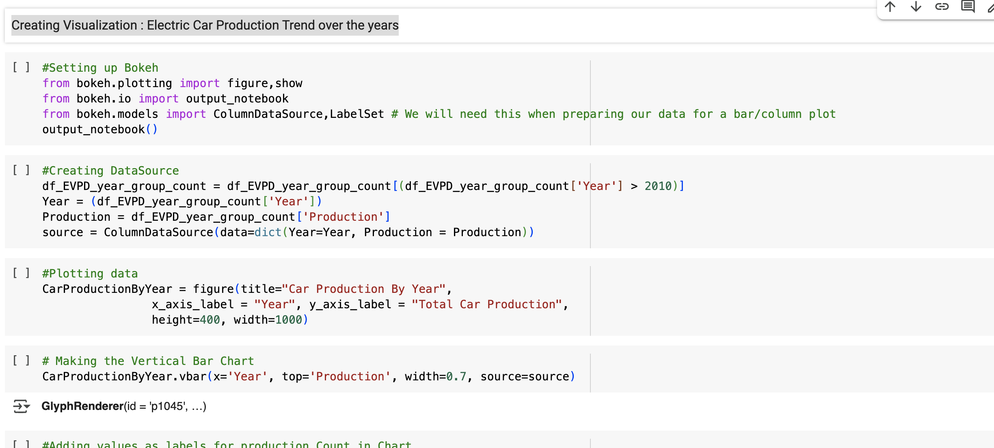
Creating Visualization : Electric Car Population Trend over the years

Slide 25

Creating Visualization : Electric Car Population Trend over the years

Slide 26
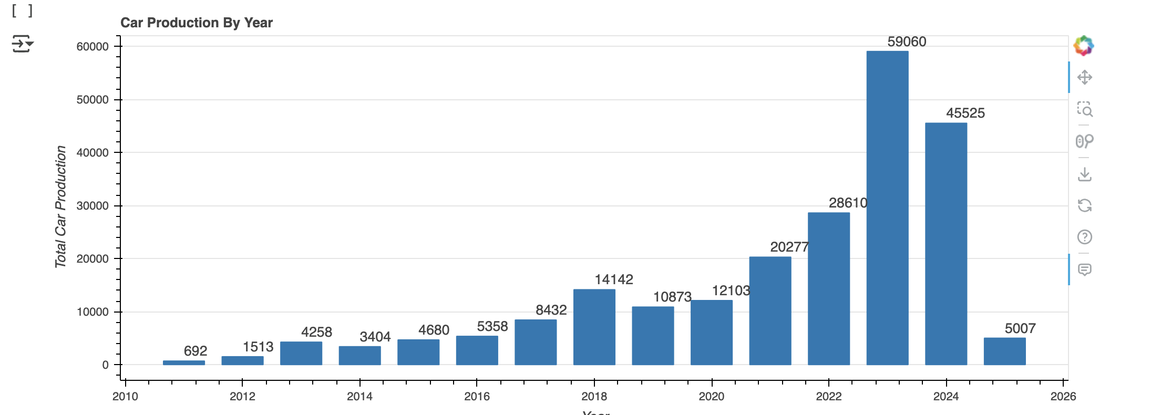
Creating Visualization : Electric Car Population Trend over the years

Slide 27
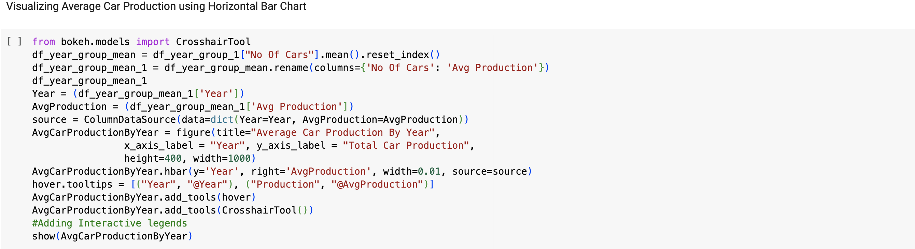
Visualizing Average Electric Car Population Over the Years

Slide 28
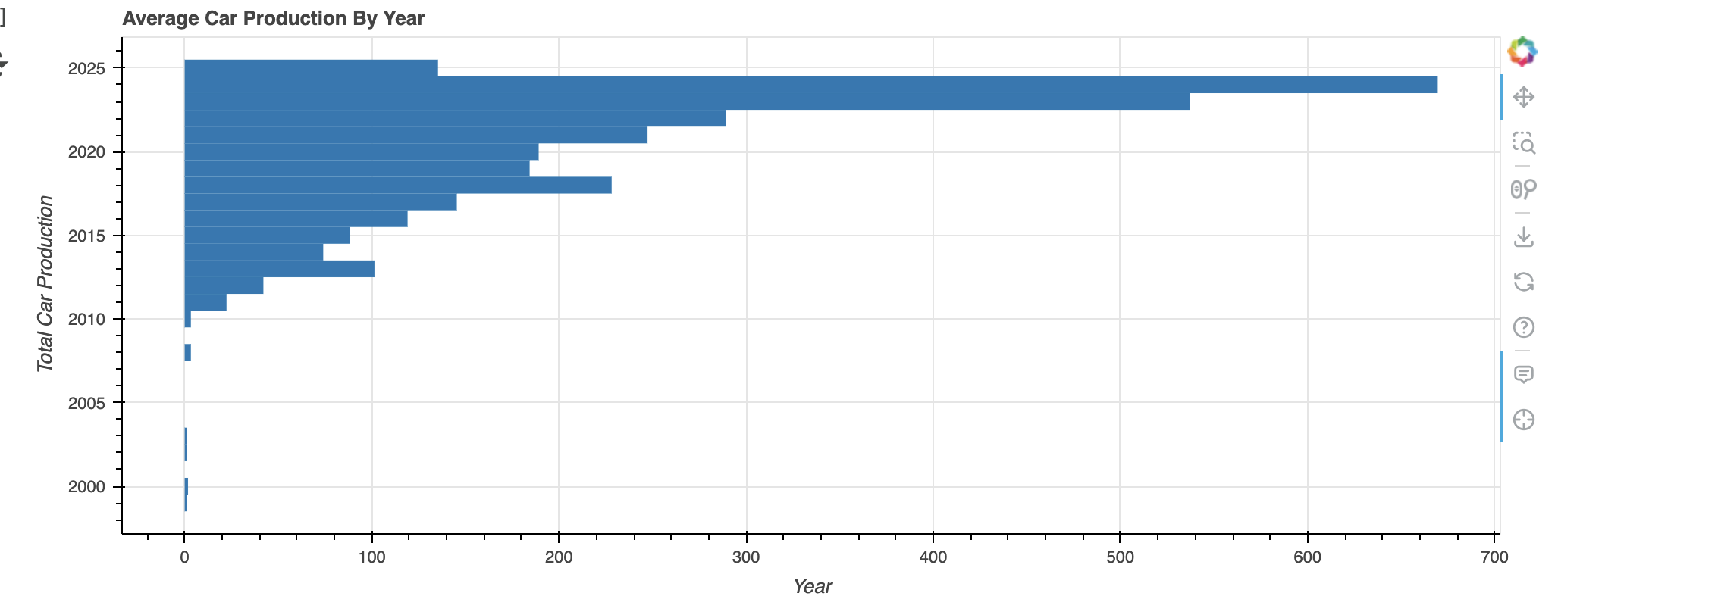
Visualizing Average Electric Car Population Over the Years

Slide 29
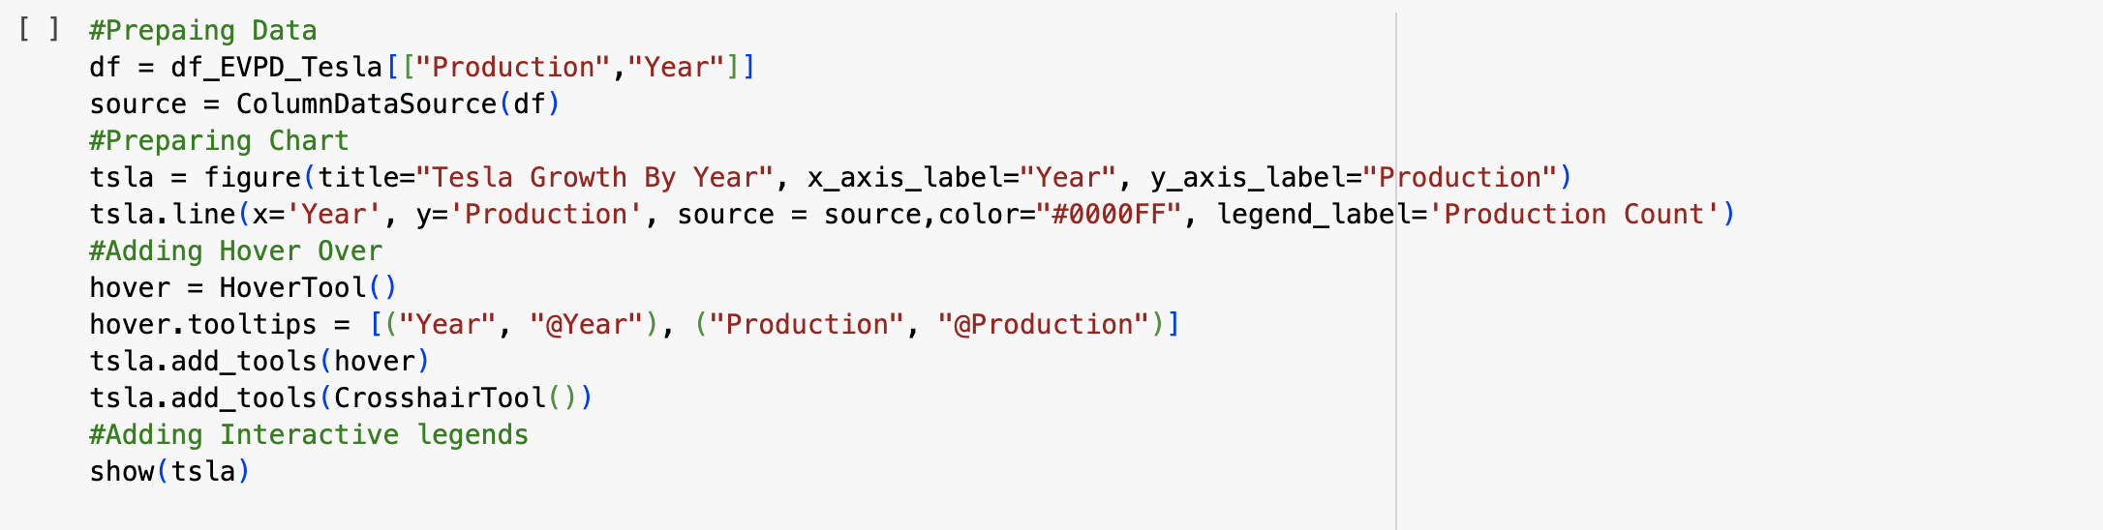
Visualizing the Growth of Tesla Over the years

Slide 30
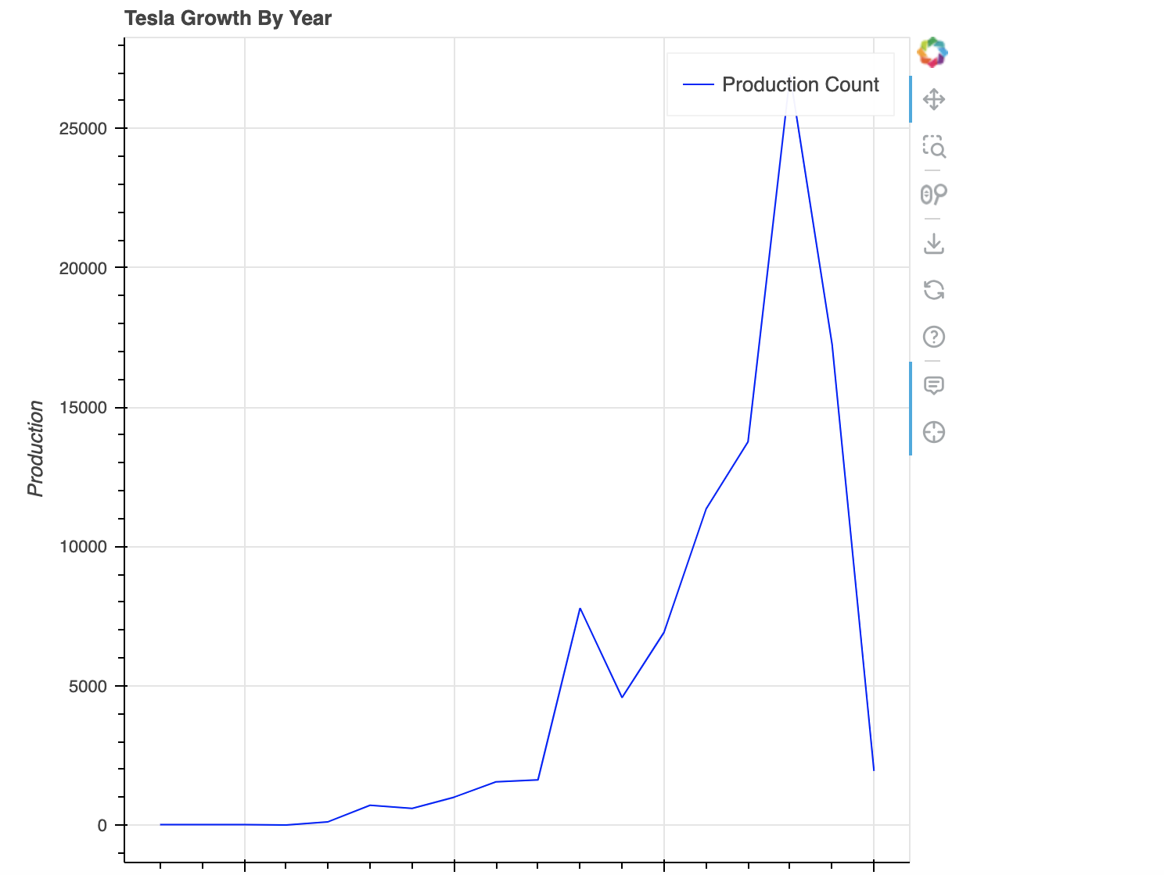
Visualizing the Growth of Tesla Over the years

Slide 31
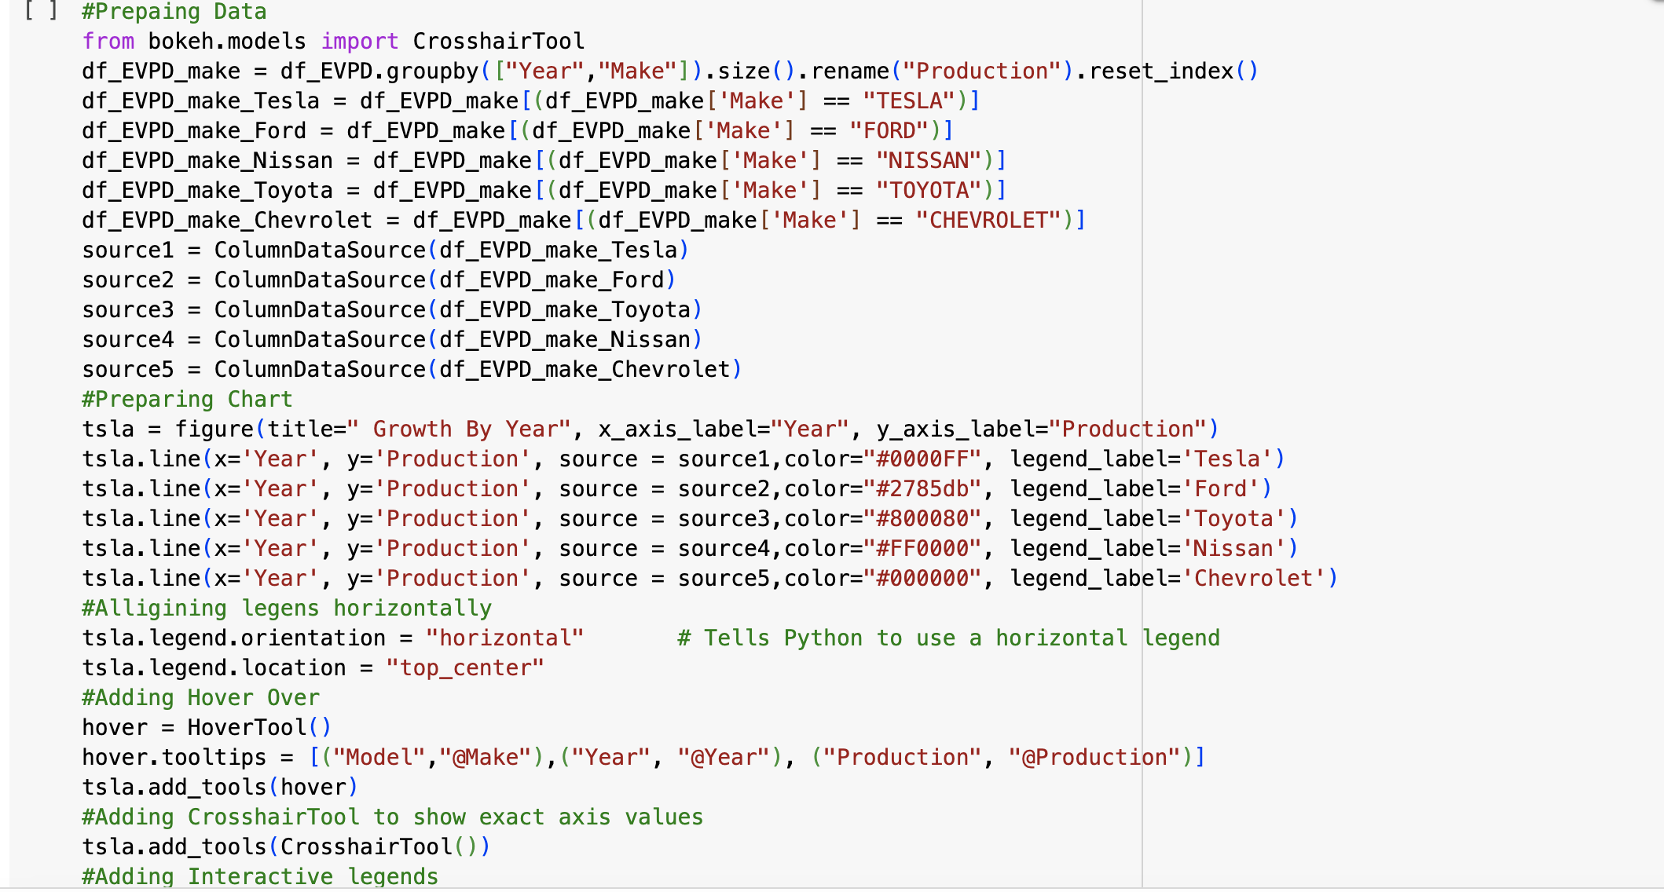
Visualizing the growth of popular models over the years

Slide 32
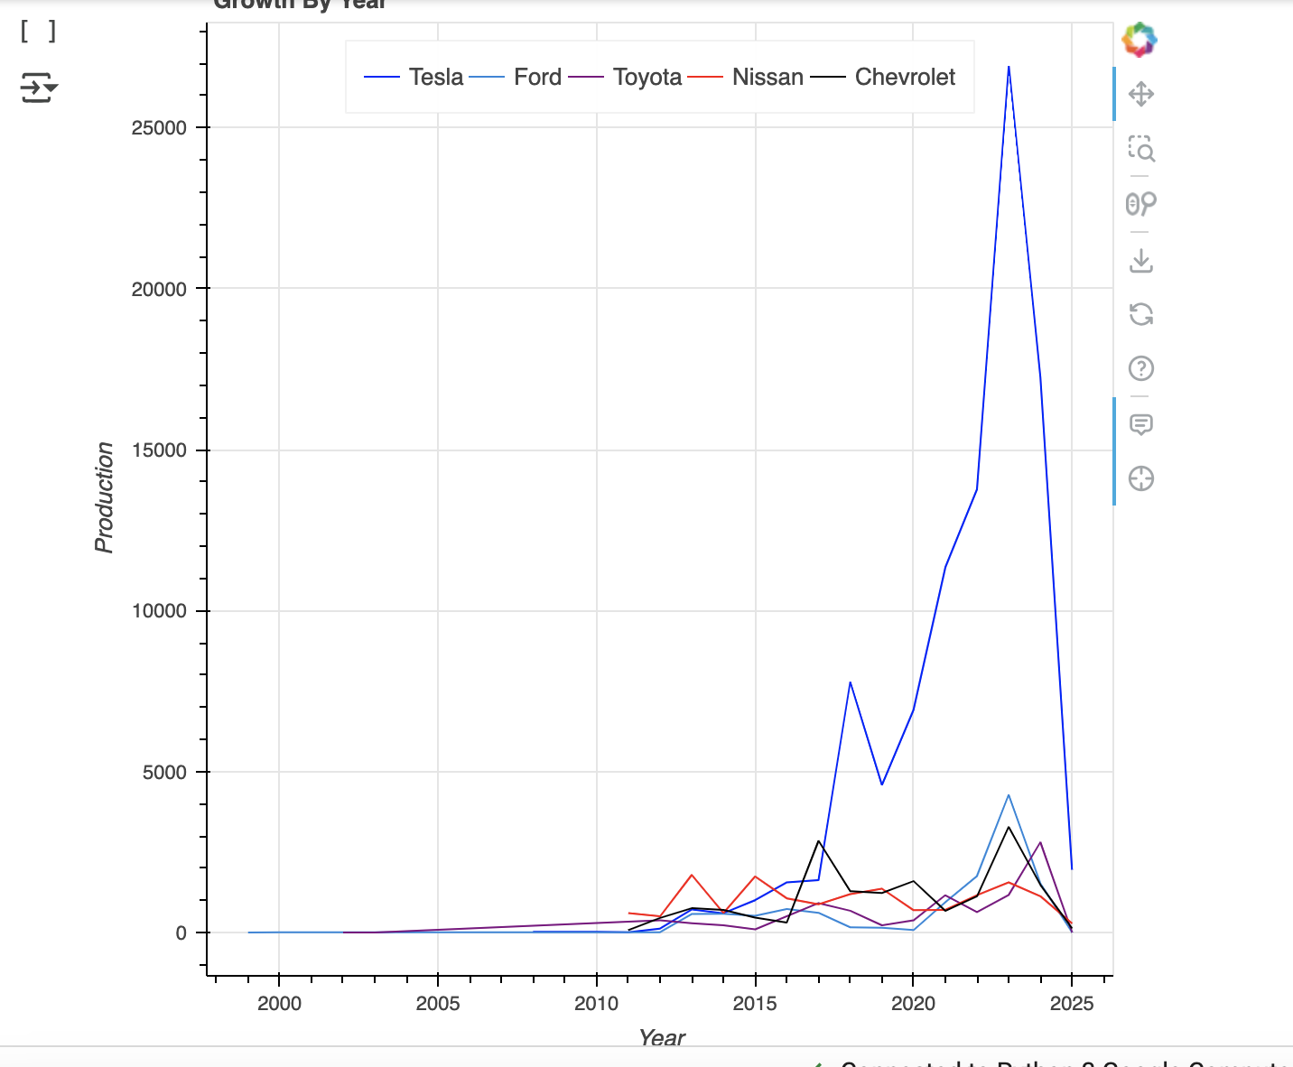
Visualizing the growth of popular models over the years

Slide 33
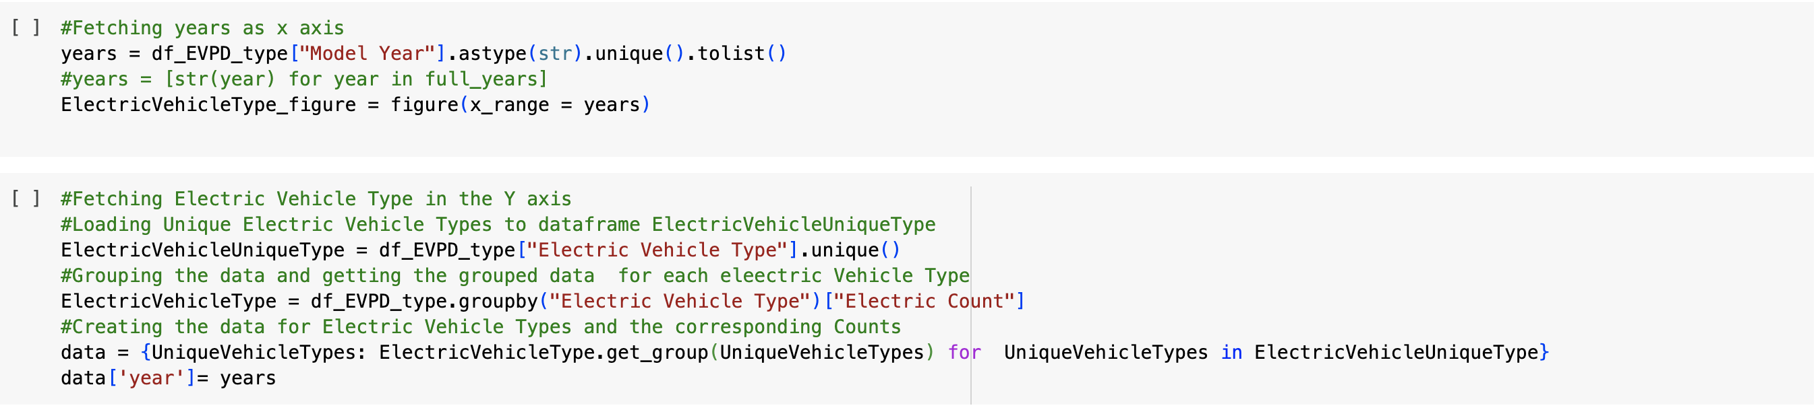
Visualizing the BEVs and PHEVs Comparison Over the Years : Stacked Bar Chart

Slide 34
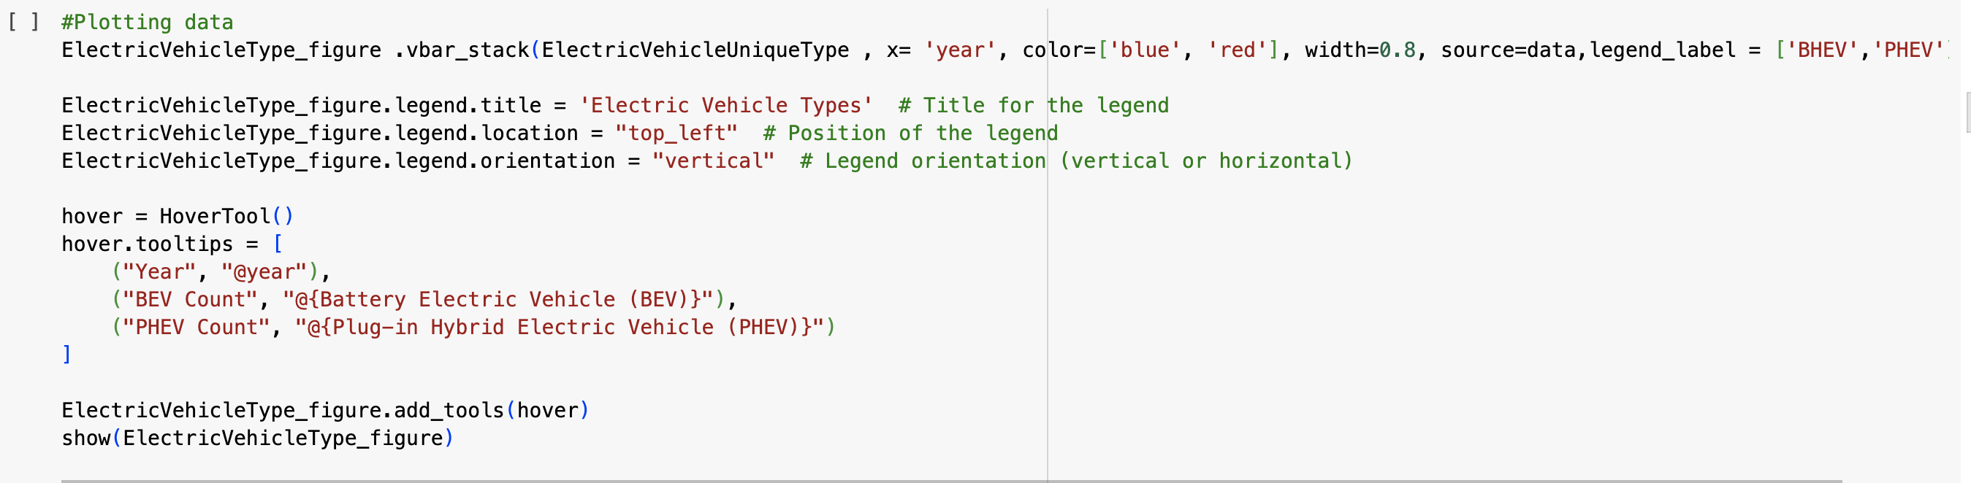
Visualizing the BEVs and PHEVs Comparison Over the Years : Stacked Bar Chart

Slide 35
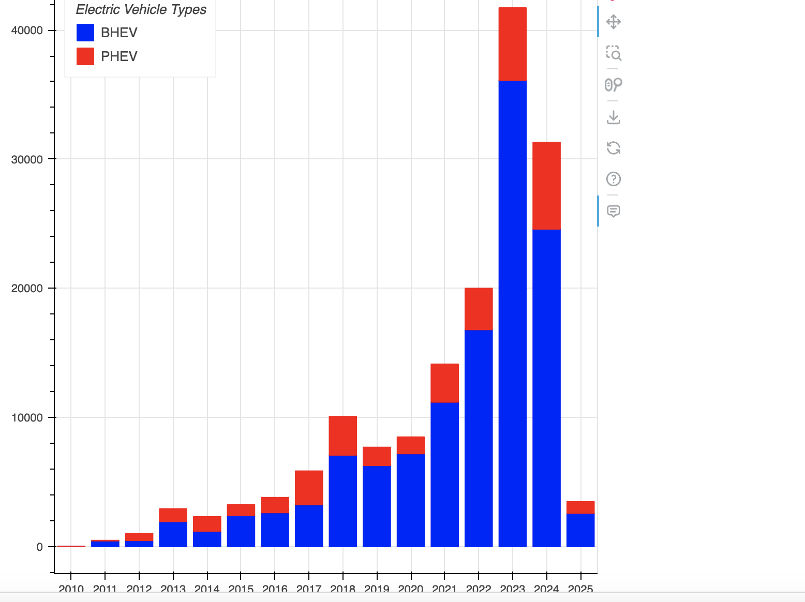
Visualizing the BEVs and PHEVs Comparison Over the Years : Stacked bar Chart

Slide 36
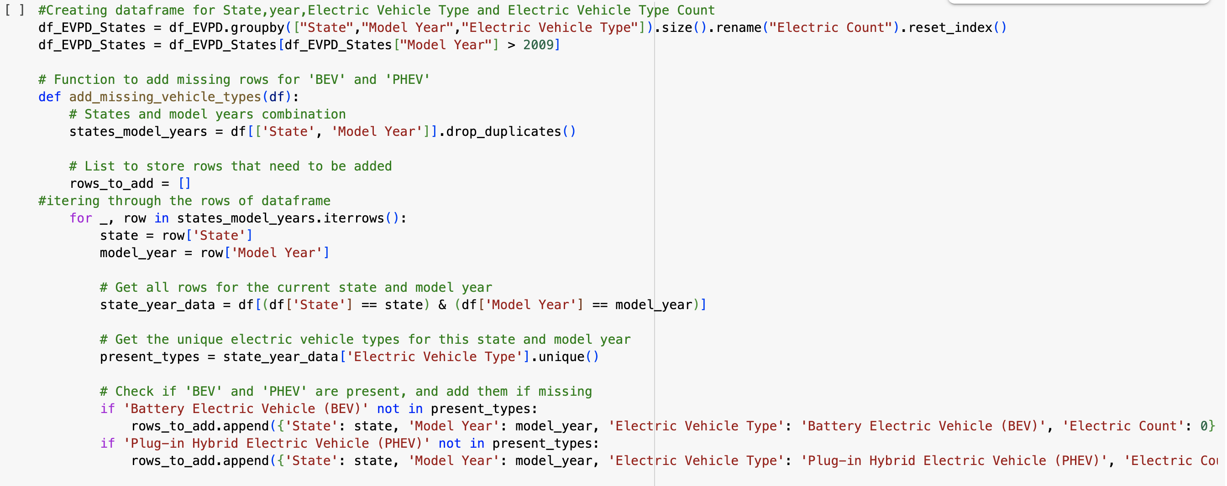
State-wise Comparison of BEVs and PHEVs Over the Years : Grid Lay Out Dashboard

Slide 37
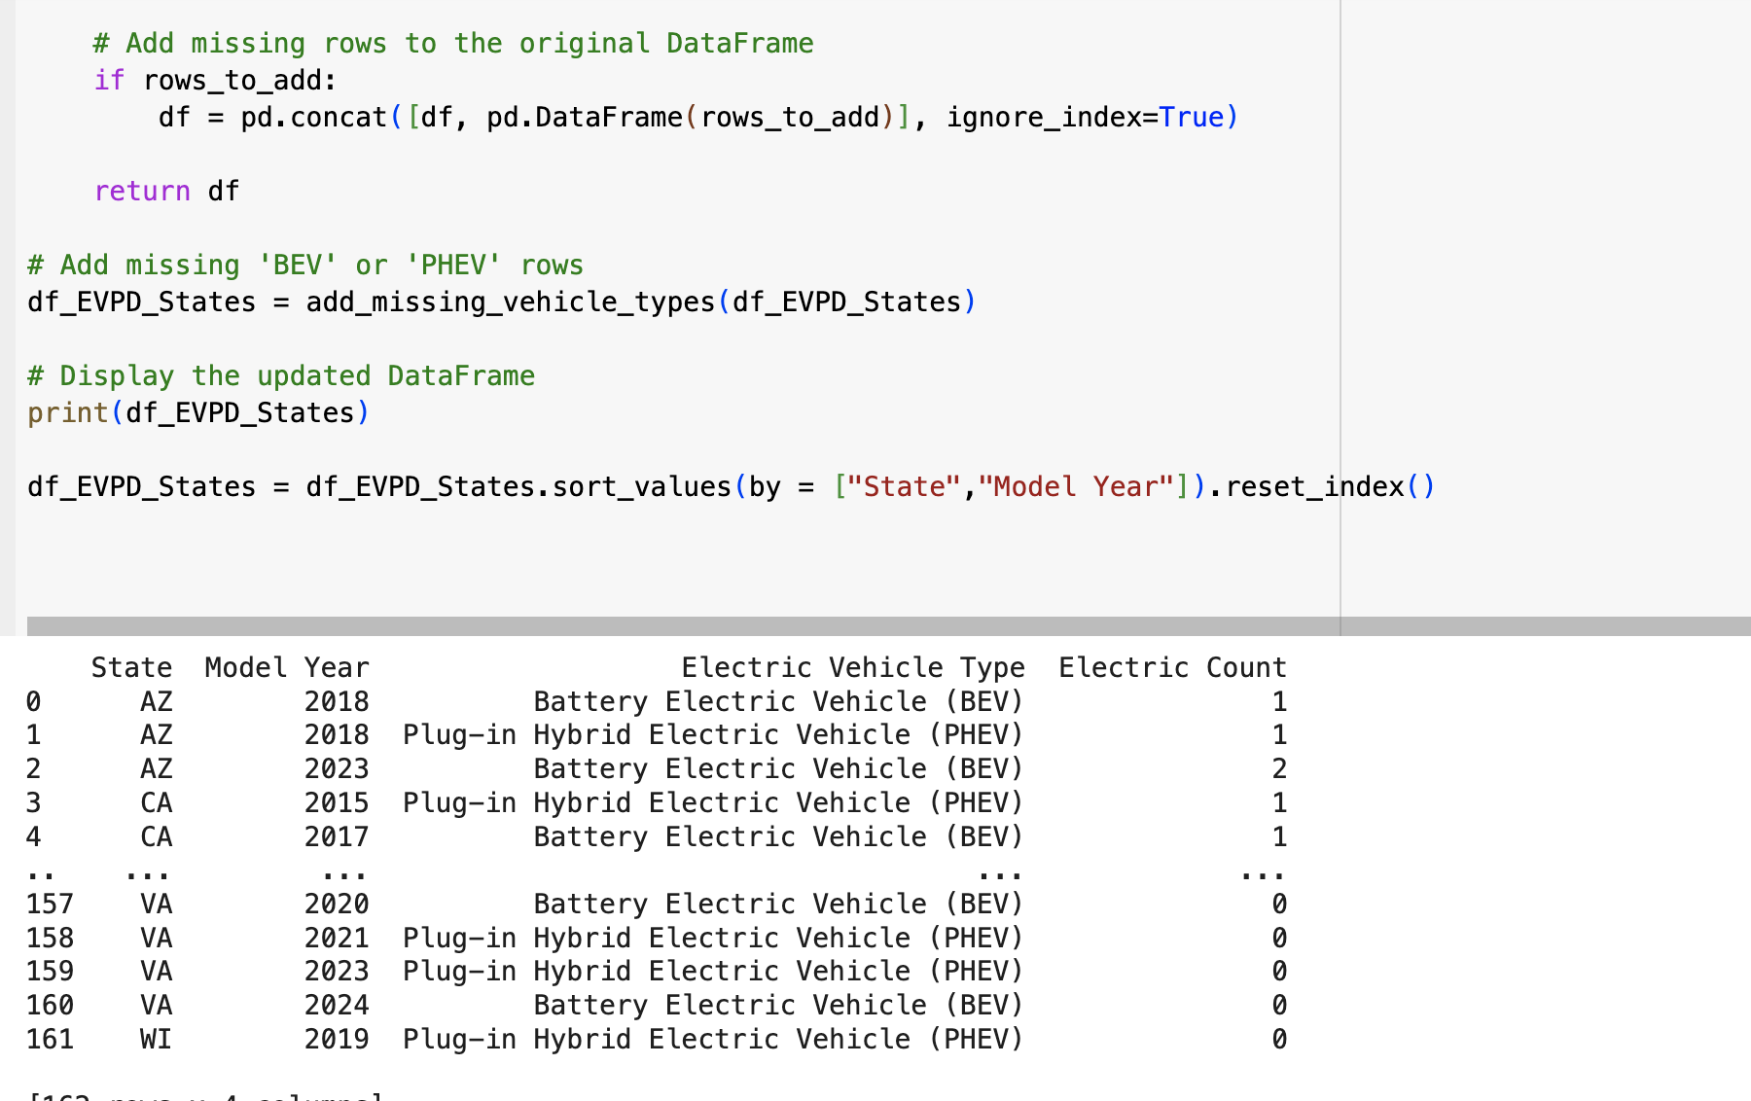
State-wise Comparison of BEVs and PHEVs Over the Years : Grid Lay Out Dashboard

Slide 38
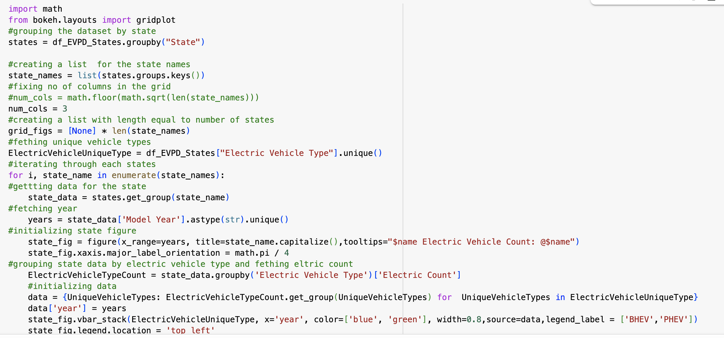
State-wise Comparison of BEVs and PHEVs Over the Years : Grid Lay Out Dashboard

Slide 39
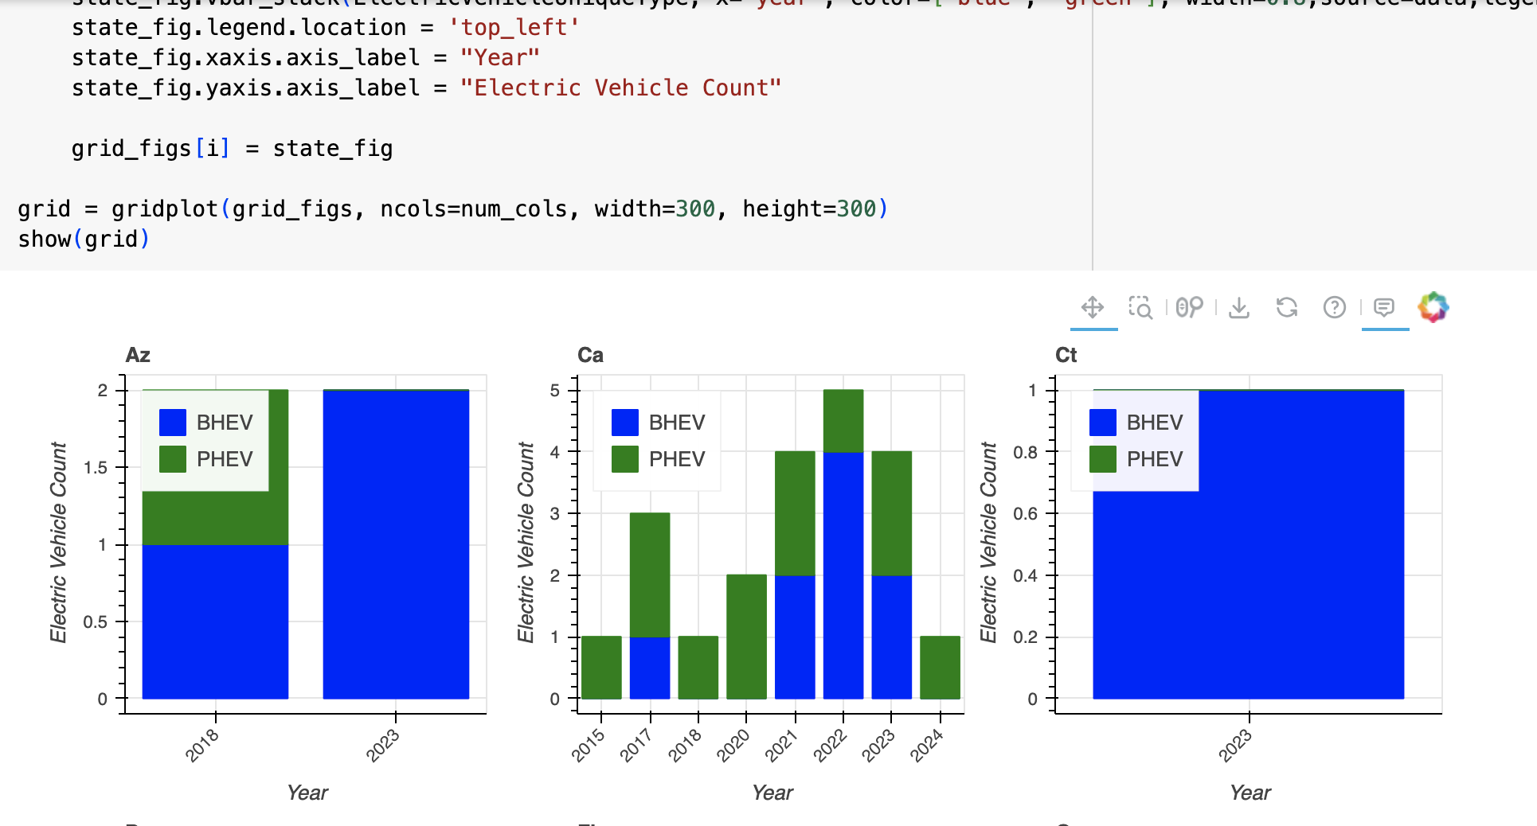
State-wise Comparison of BEVs and PHEVs Over the Years : Grid Lay Out Dashboard

Slide 40
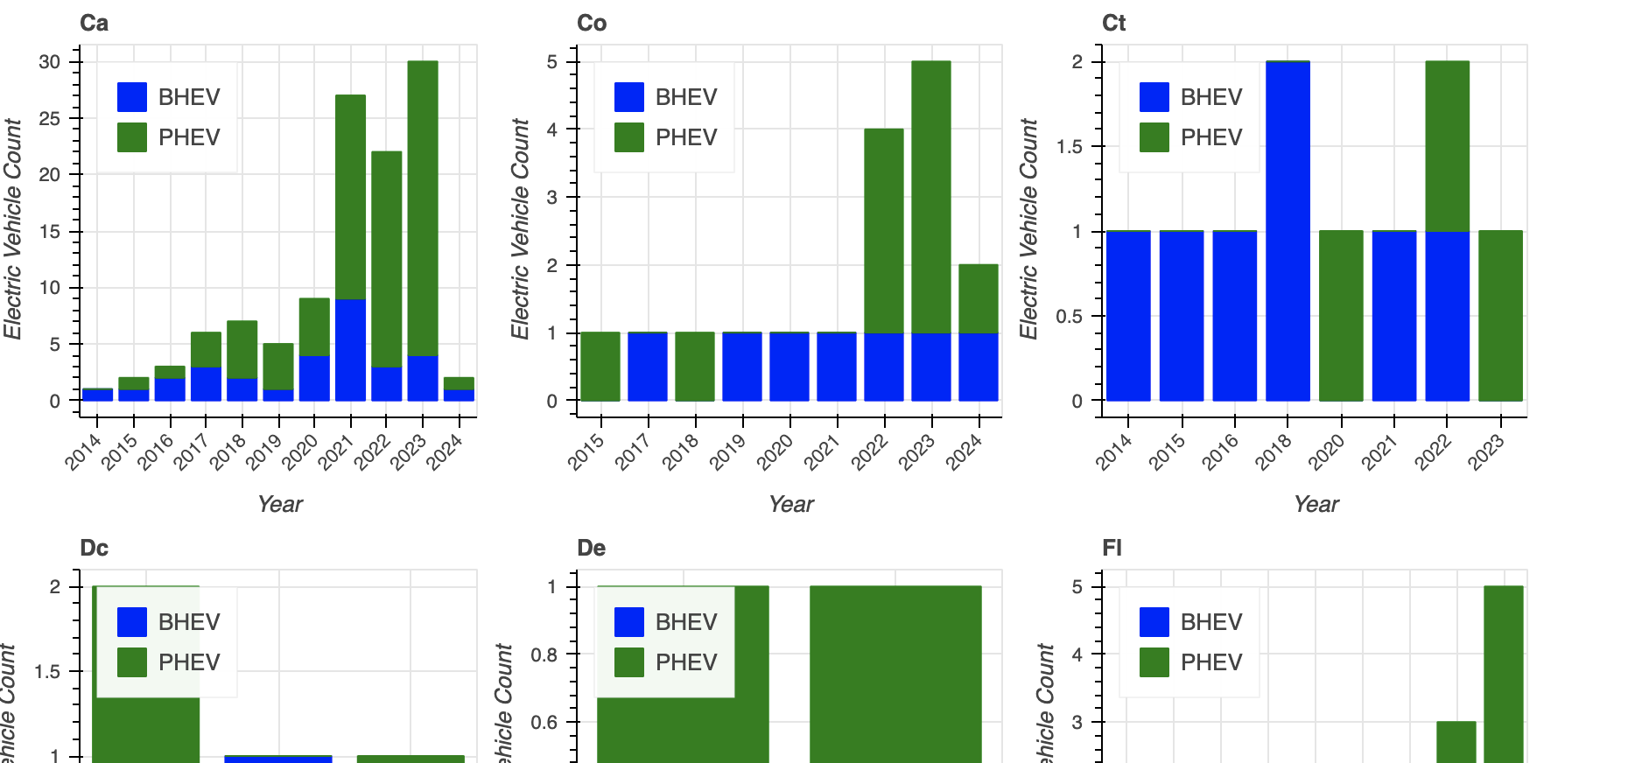
State-wise Comparison of BEVs and PHEVs Over the Years : Grid Lay Out Dashboard

Slide 41

State-wise Comparison of BEVs and PHEVs Percentage Over the Years : Grid Lay Out Dashboard

Slide 42

State-wise Comparison of BEVs and PHEVs Percentage Over the Years : Grid Lay Out Dashboard

Slide 43

State-wise Comparison of BEVs and PHEVs Percentage Over the Years : Grid Lay Out Dashboard

Slide 44
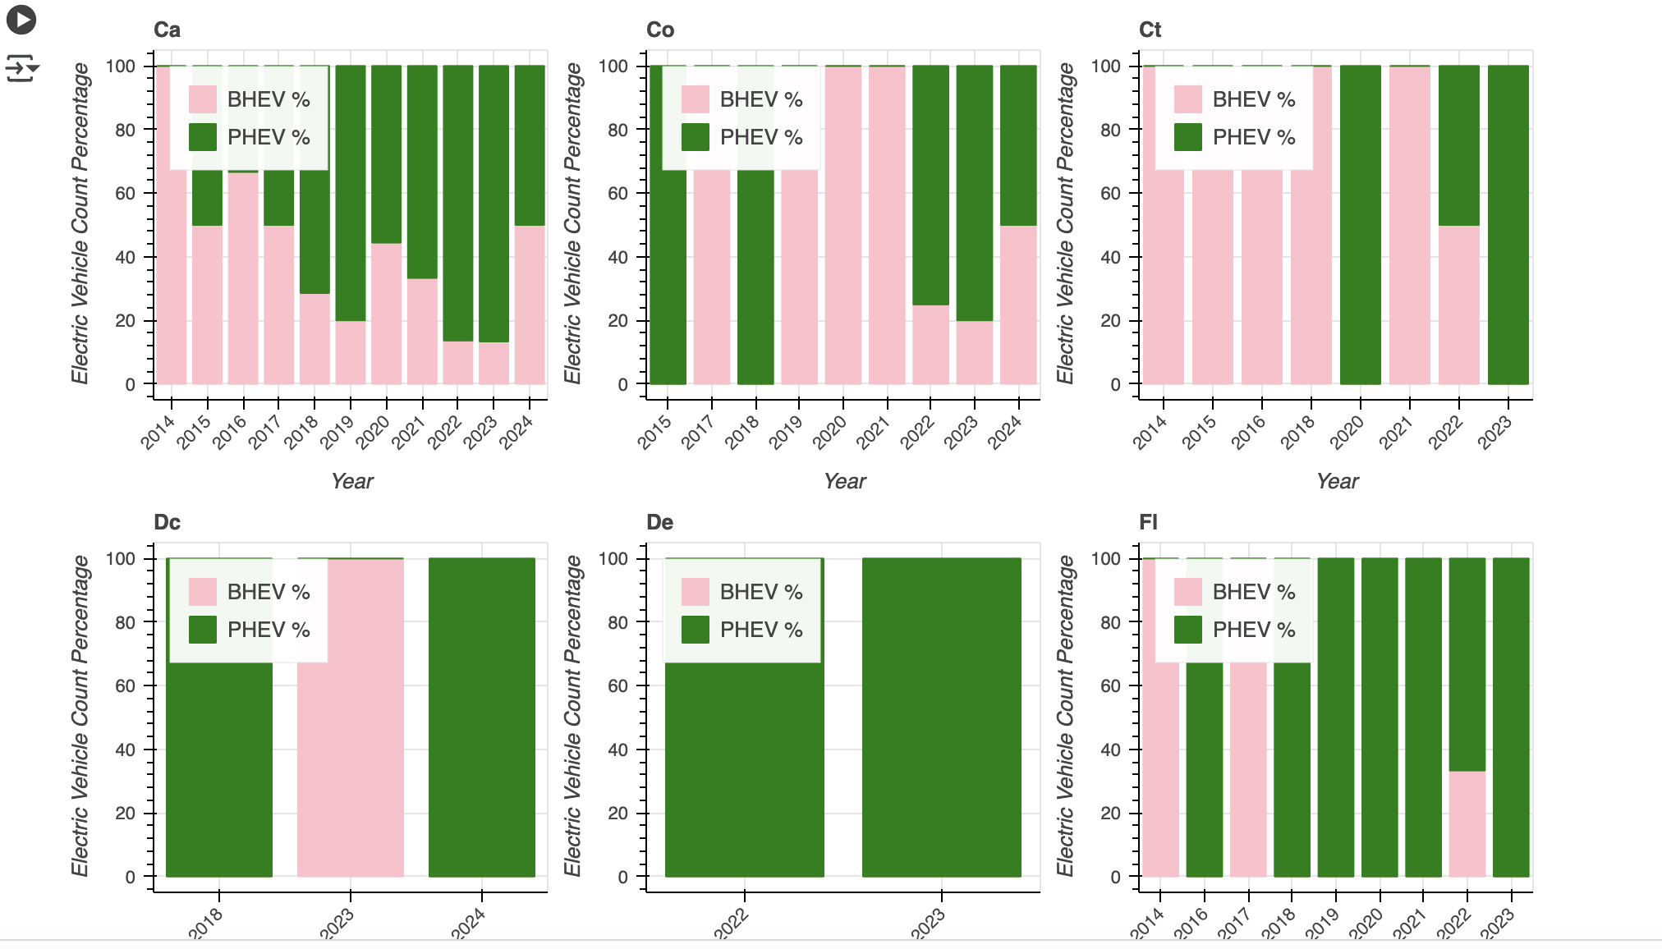
State-wise Comparison of BEVs and PHEVs Percentage Over the Years : Grid Lay Out Dashboard

Slide 45
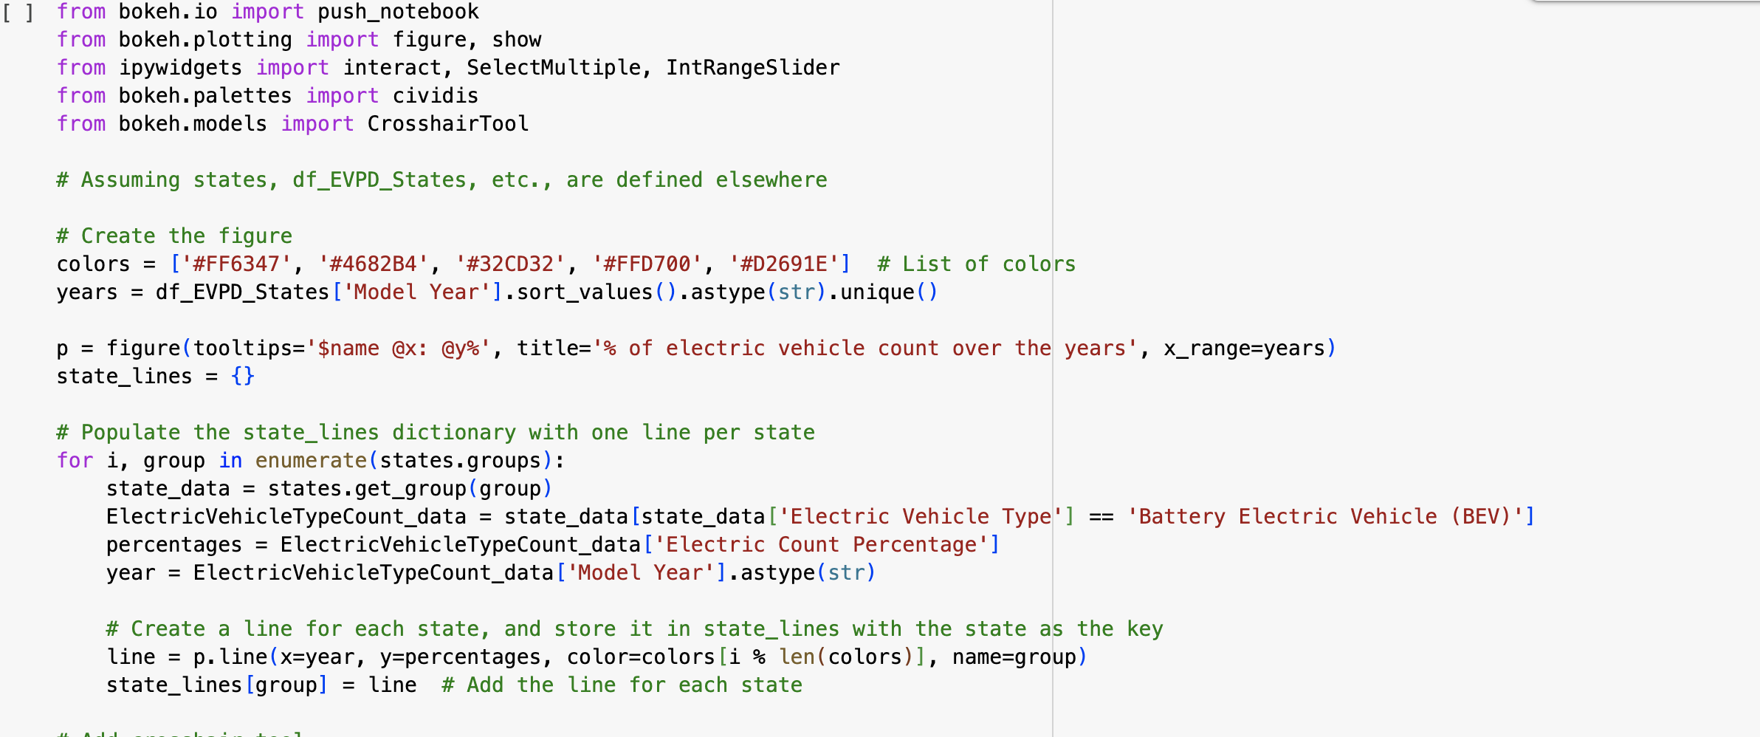
State-wise Comparison of BEVs and PHEVs Percentage Over the Years :Interactive Line graph

Slide 46

State-wise Comparison of BEVs and PHEVs Percentage Over the Years :Interactive Line graph

Slide 47
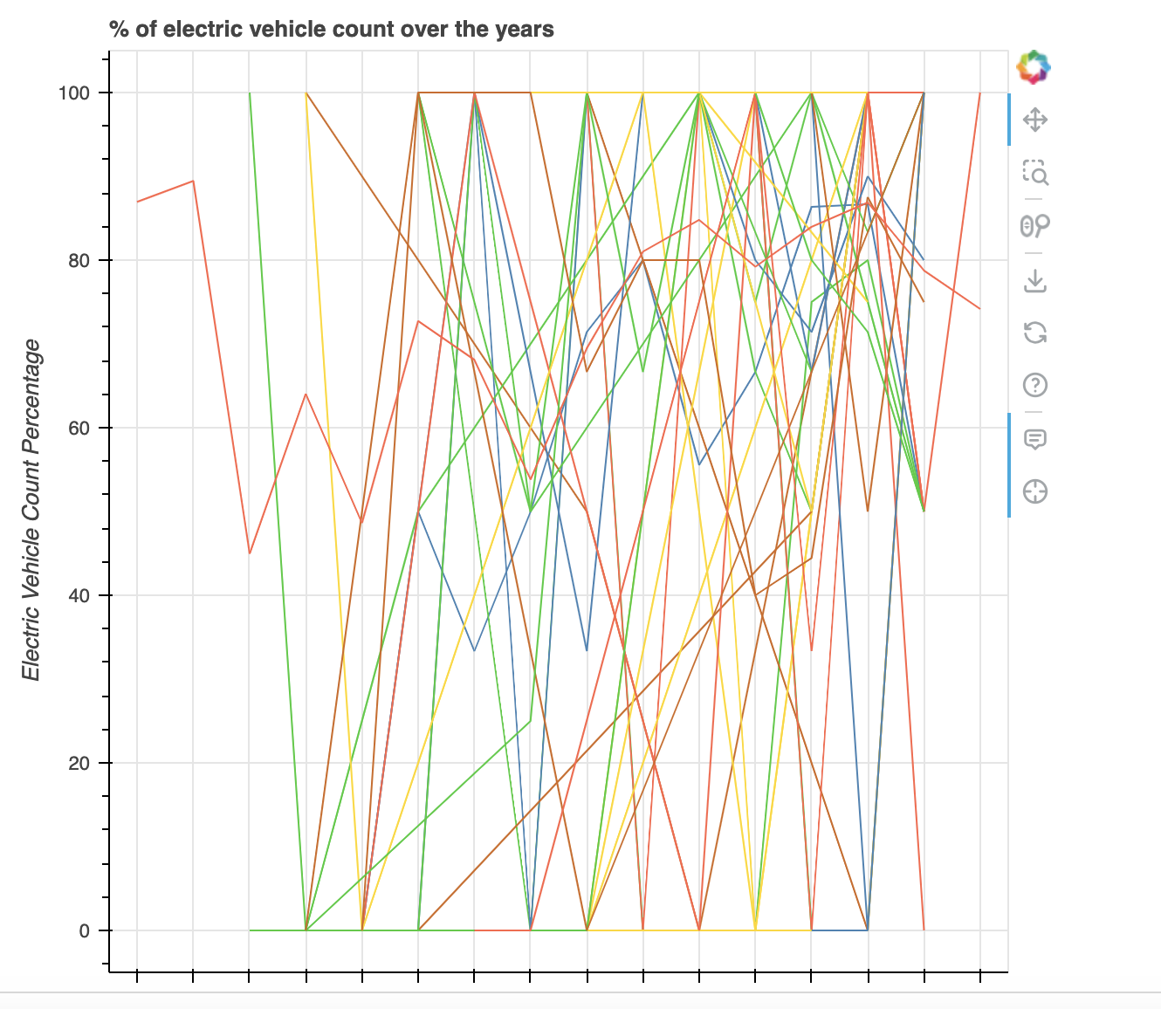
State-wise Comparison of BEVs and PHEVs Percentage Over the Years :Interactive Line graph

Slide 48
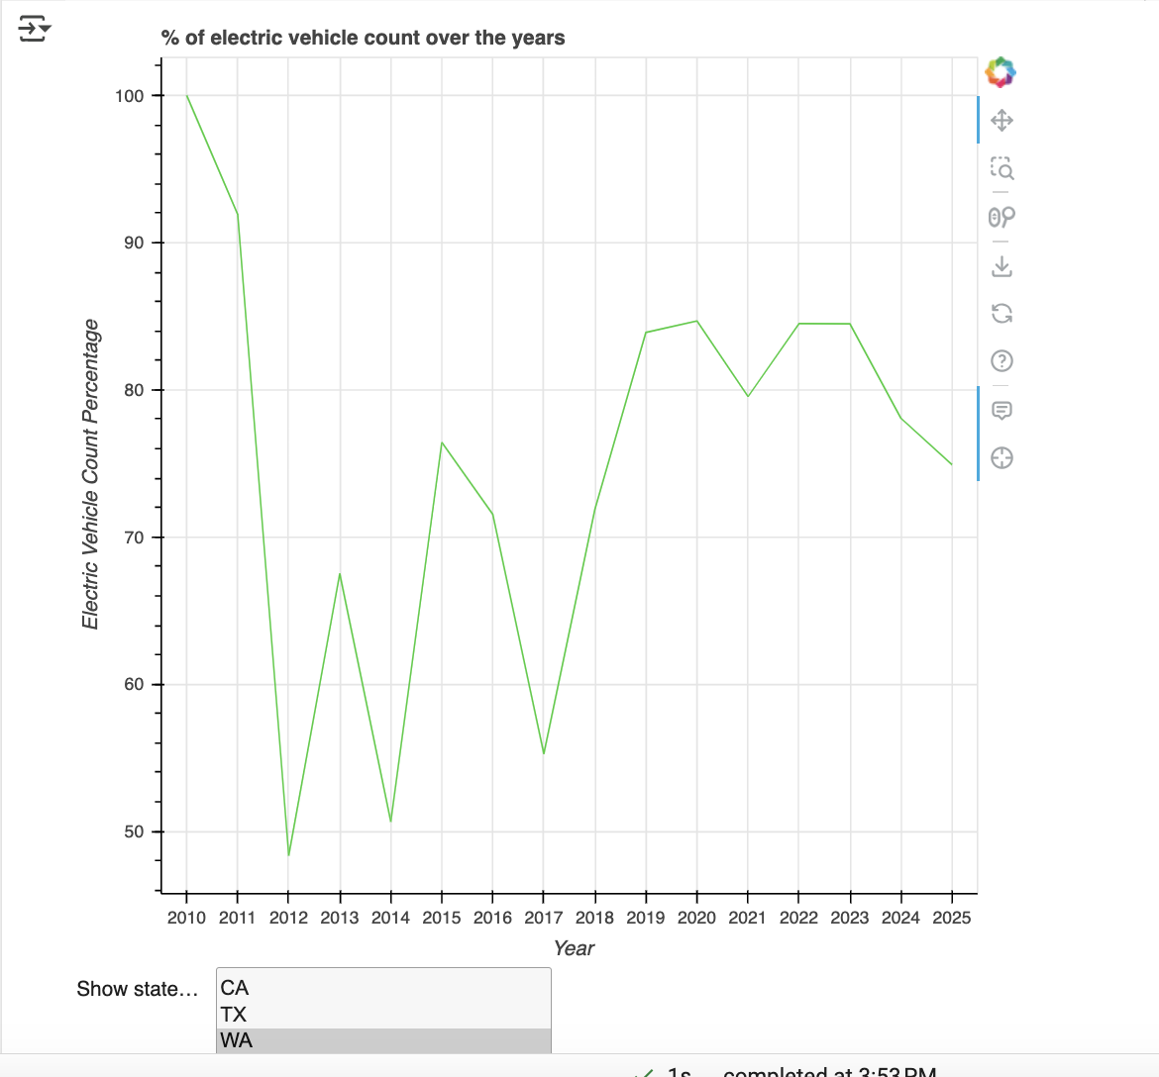
State-wise Comparison of BEVs and PHEVs Percentage Over the Years :Interactive Line graph

Slide 49

State-wise Comparison of BEVs and PHEVs Percentage Over the Years :Map Chart

Slide 50
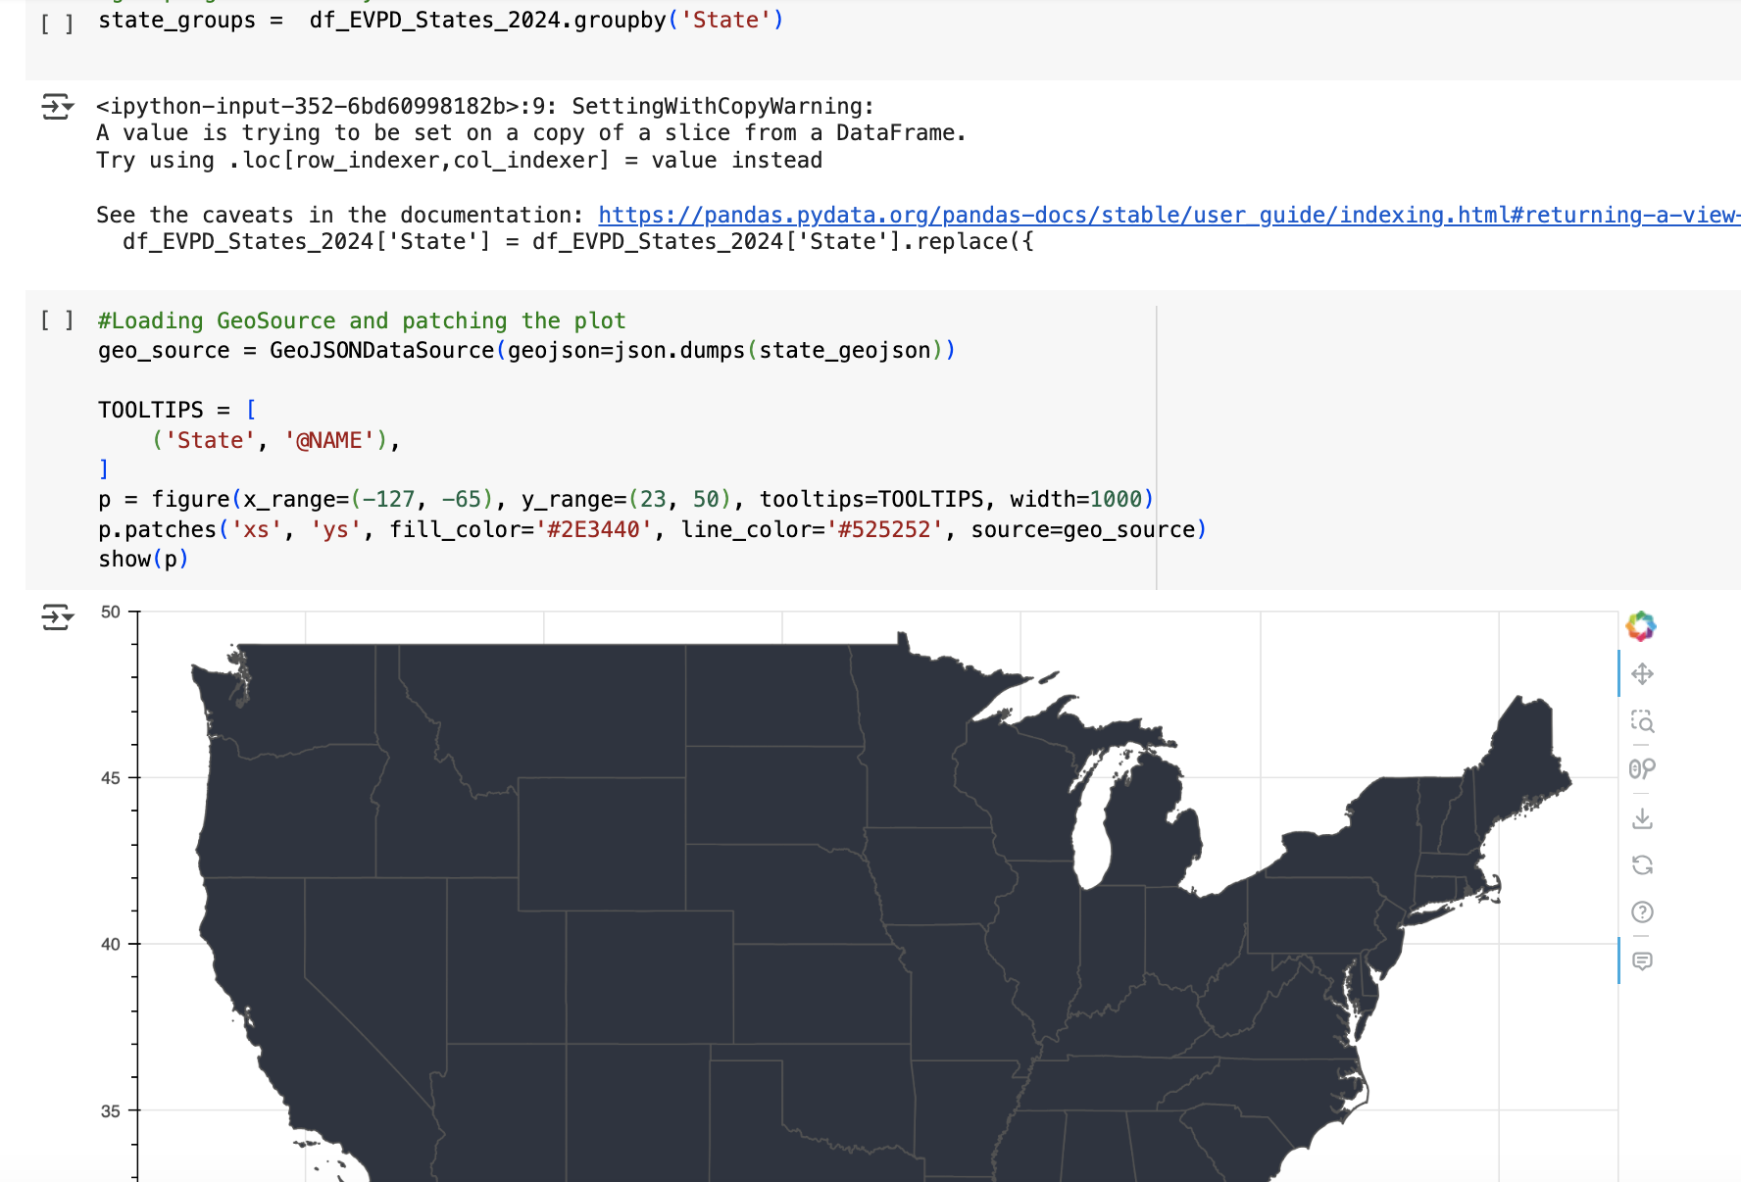
State-wise Comparison of BEVs and PHEVs Percentage Over the Years :Map Chart

Slide 51

State-wise Comparison of BEVs and PHEVs Percentage Over the Years :Map Chart

Slide 52
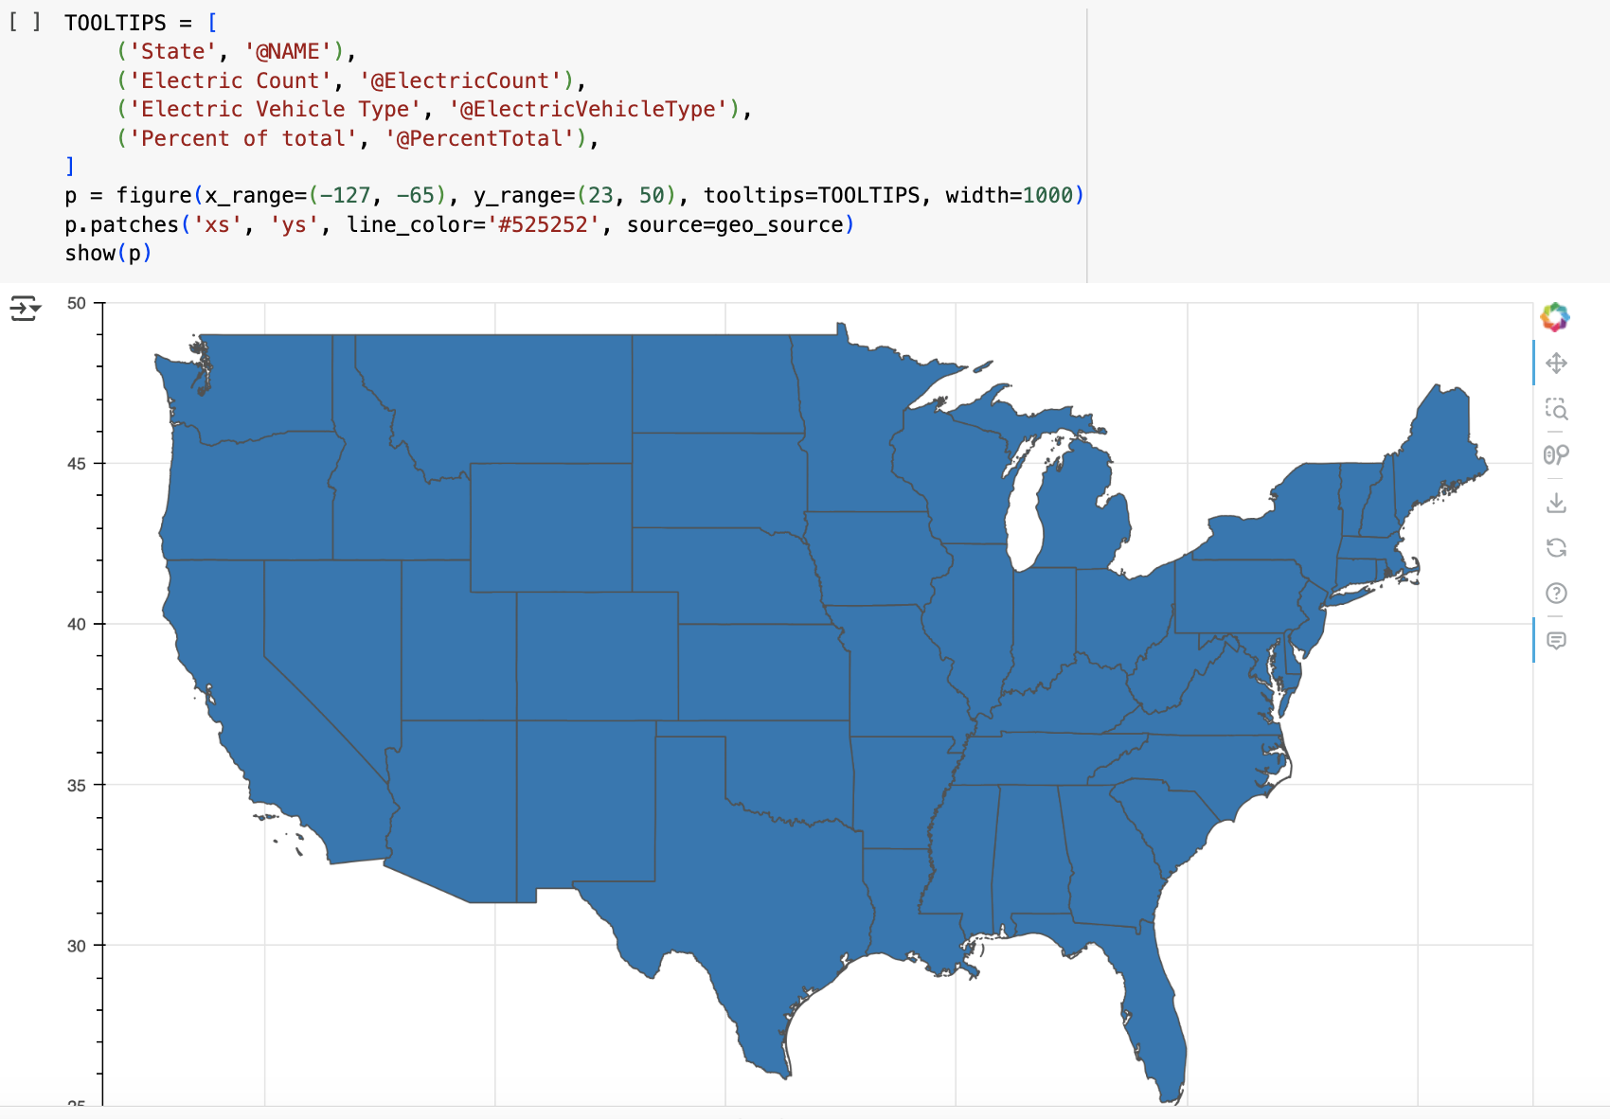
State-wise Comparison of BEVs and PHEVs Percentage Over the Years :Map Chart

Slide 53
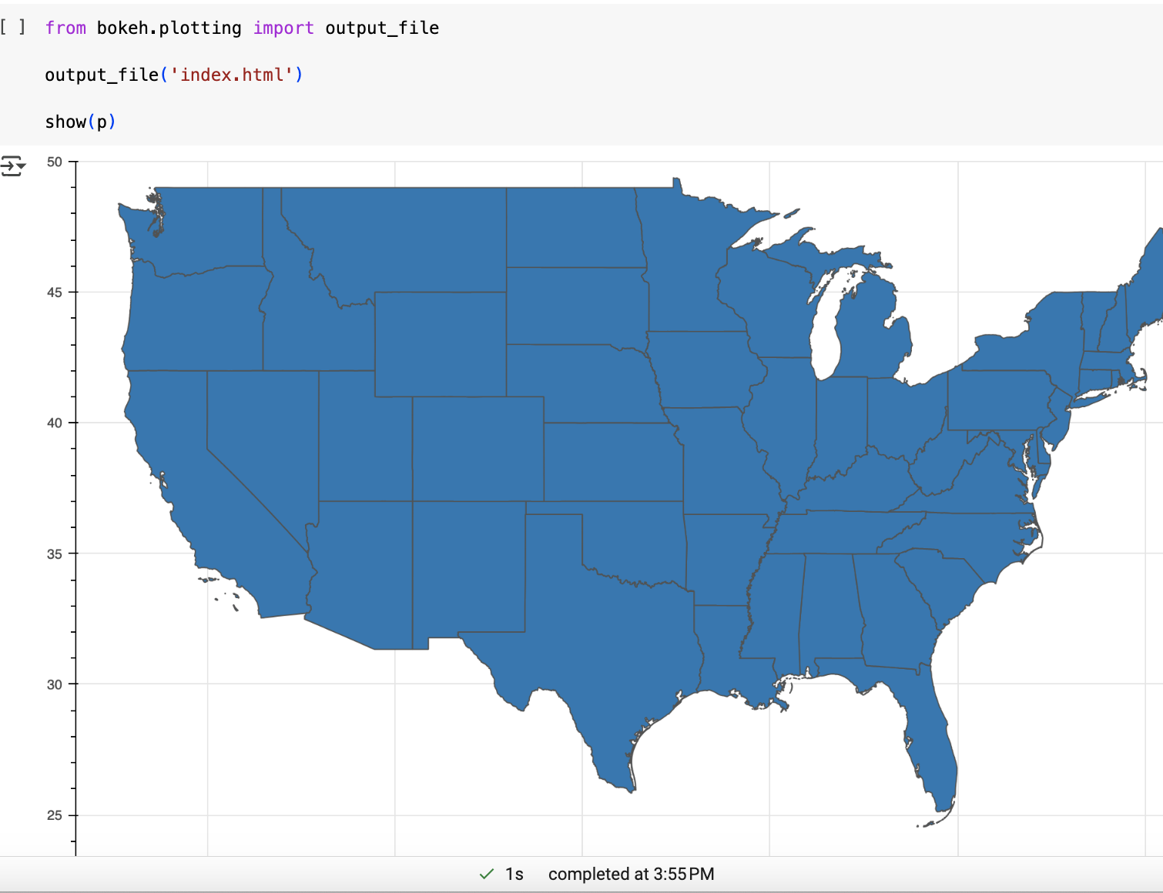
State-wise Comparison of BEVs and PHEVs Percentage Over the Years :Map Chart
https://electricvehiclepopulation-7c7477.netlify.app/

Slide 54
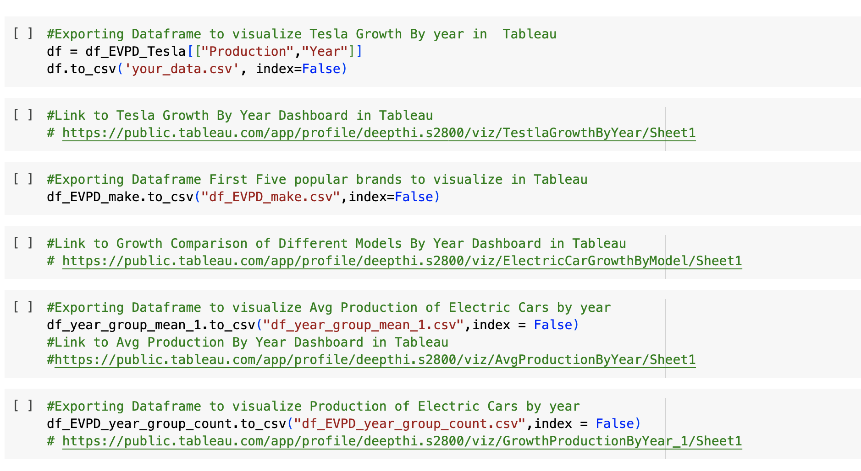
Creating Visualizations in Tableau

Slide 55
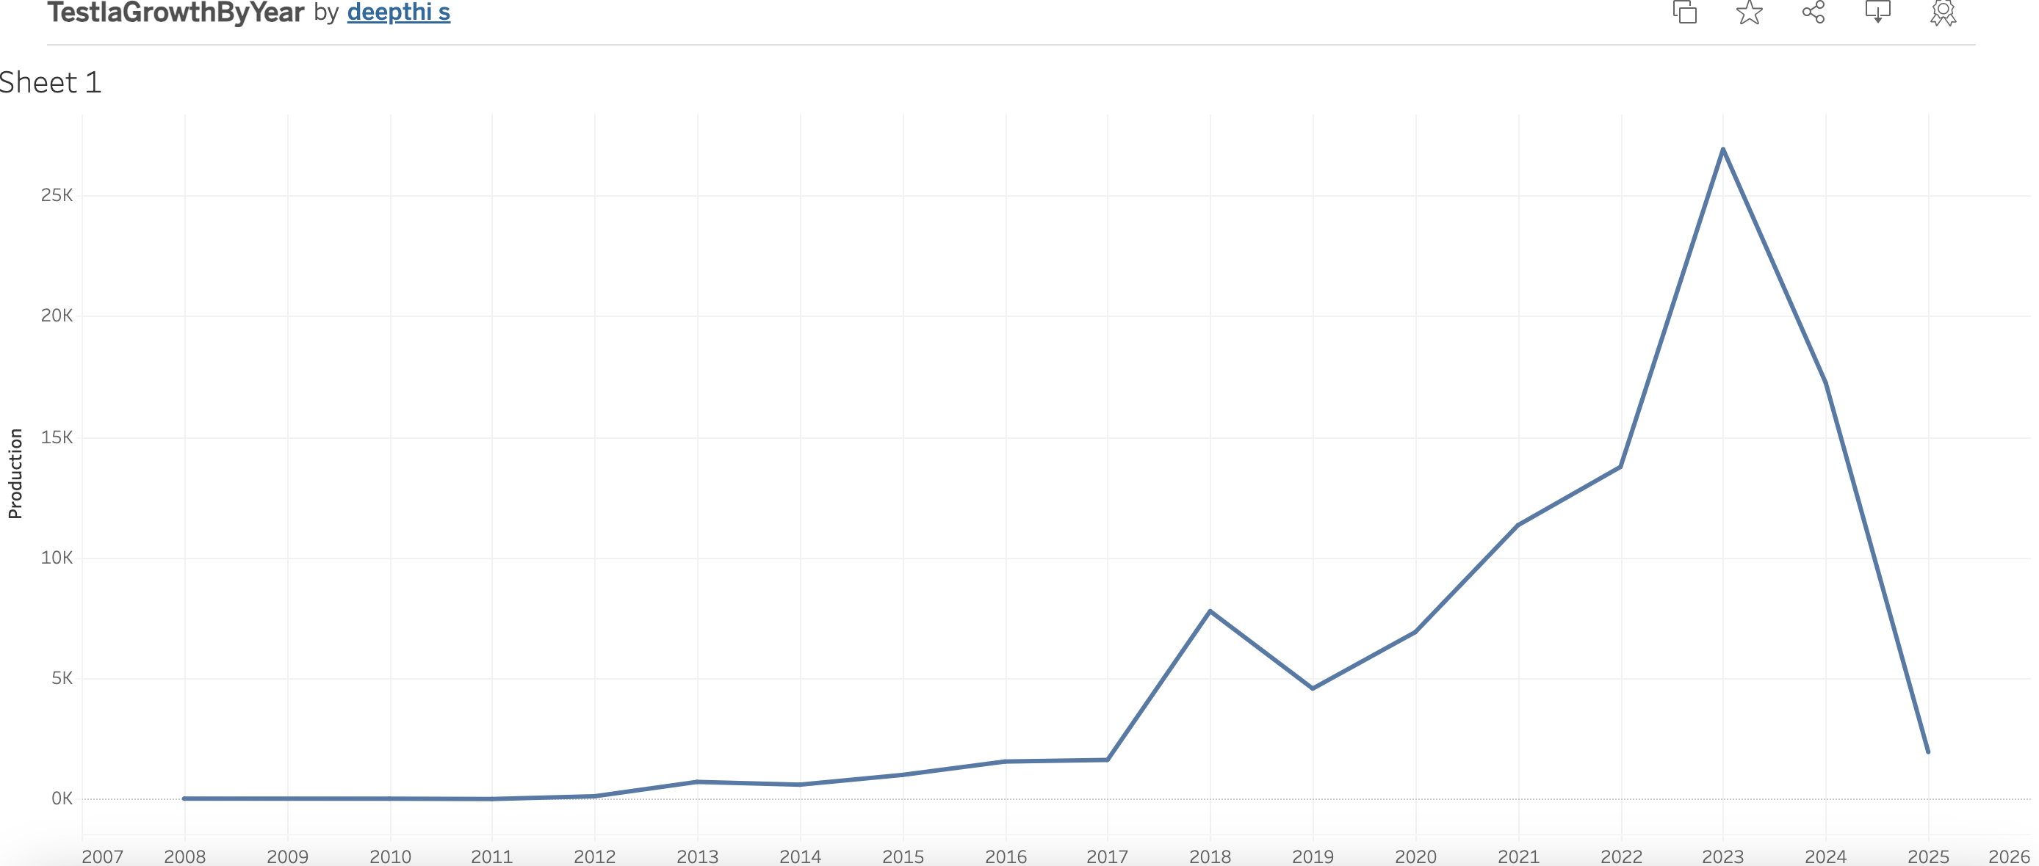
Dashboard : Tesla Growth By Year

Slide 56
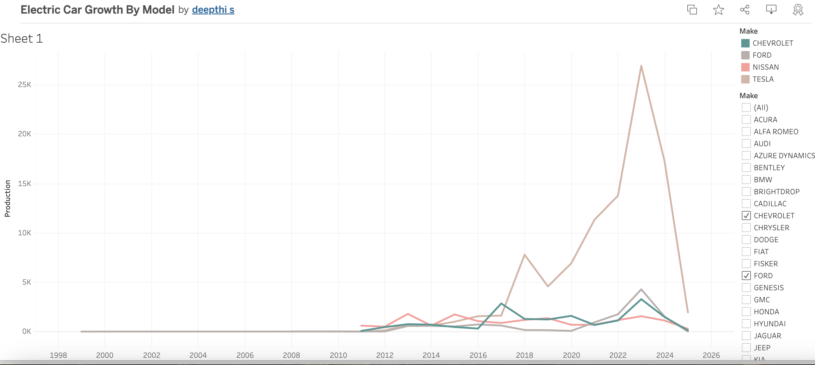
Dashboard : Electric Car Growth By Model Over the Years

Slide 57
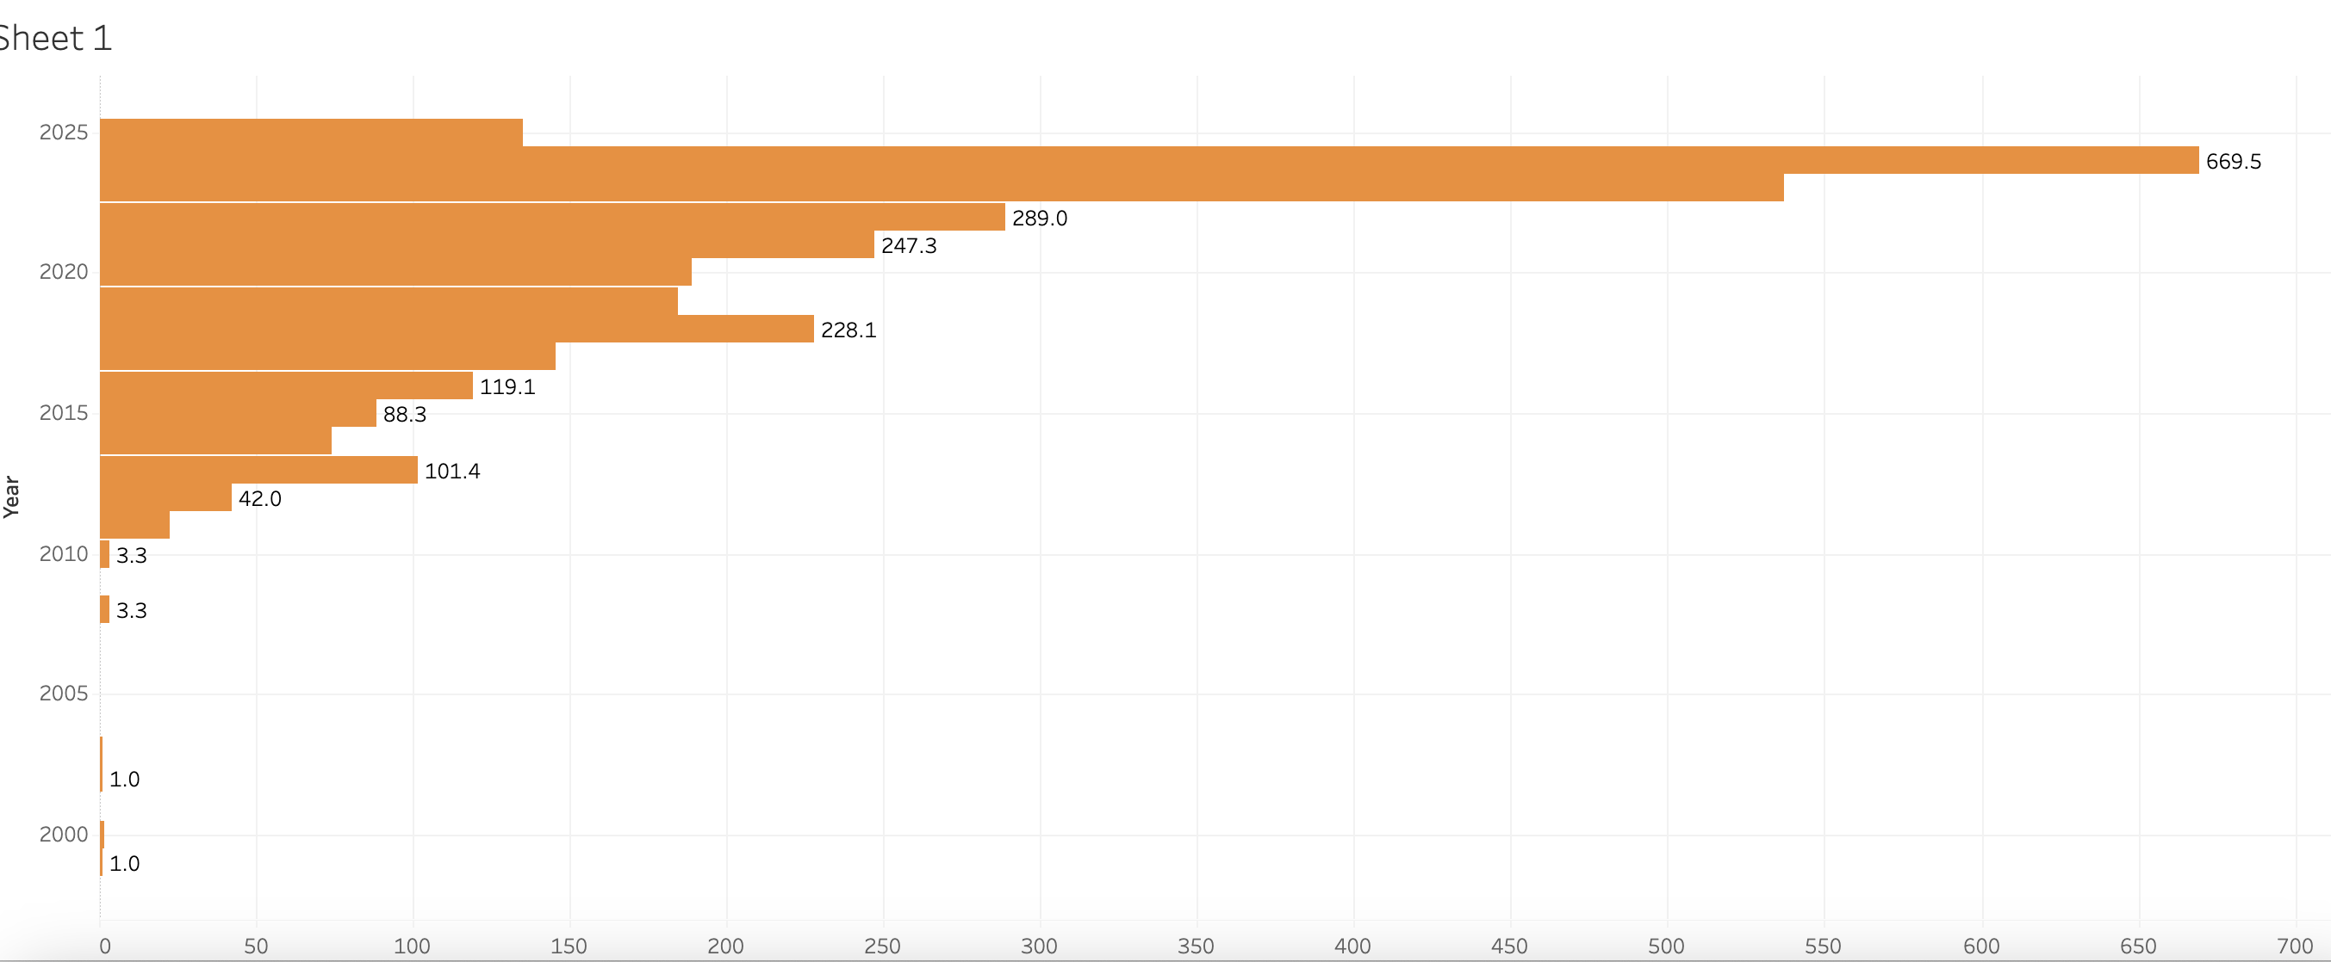
Dashboard: Average population of Electric Car over the years

Slide 58
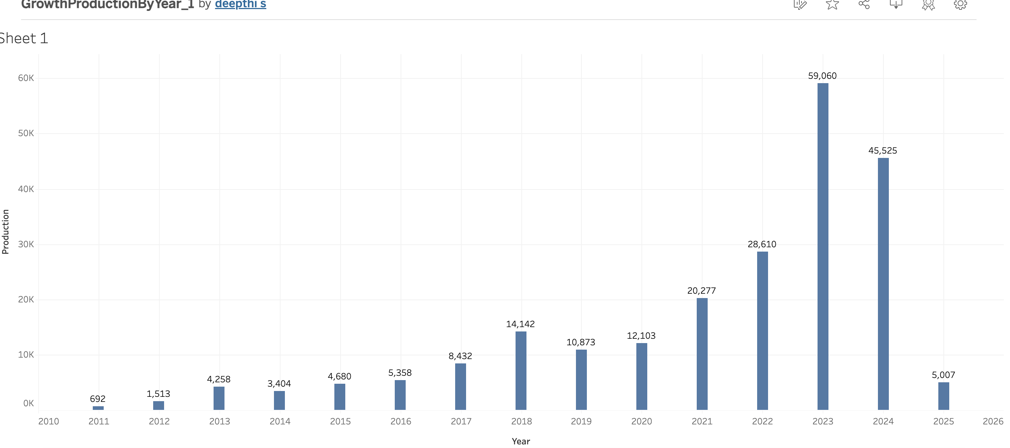
Dashboard : Electric Car Model Population Over the years

Slide 59
Conclusion
The Electric Vehicle sector has experienced a significant growth over the years.
Notably, the data shows a consistent increase in the production and adoption of electric vehicles for a few states . The states WA,CA,VA,MD and TX shows a very remarkable growth .
While Comparing the growth of all the models, Tesla’s growth trajectory stands out indicating its strong presence in the market.
Overall, The analysis explains the growing influence of Electric Vehicle in the Industry.

Slide 60
THANK YOU

